Slide 1





Noida Institute of Engineering and Technology, Greater Noida
PREDICTIVE ANALYTICS
Unit: 5
Feature Engineering
Mr. Sovers Singh Bisht
Assistant Professor
DS-DEPT
NIET
B-Tech 5TH Sem
ONLINE & Offline (Sec A, B)

Slide 2

Noida Institute of Engineering and Technology, Greater Noida
Mr. Sovers Singh Bisht
Dep. HOD (Data Science)
B.Tech, M.Tech
PH.D (P) in CSE ..
Area of Expertise: Data Science, Big Data Analytics
& Cloud Computing.

Slide 3

Evaluation Scheme
PROGRAM ELECTIVES BUCKET
DS
 | Data Analytics | Full Stack Development | Mobility Management | CRM-RPA
Program Elective 1 | Predictive Analytics | Python Web Development with Django | Mobile Application Development | CRM Fundamentals
Program Elective 2 | Web Technologies | Design Patterns | Development in Swift Fundamentals | CRM Administration
Program Elective 3 | Programming for Data Analytics | Advanced Java Programming | Development in Swift Explorations and Data Collections | CRM Development
Program Elective 4 | Social Media Analytics | Web Development using MEAN Stack | Augmented Reality and Virtual Reality | Robotics Process Automation (RPA)
Program Elective 5 | Natural language Processing | Web Development using MERN Stack | Game Programming | Robotics Process Automation (RPA) Implementation

Slide 4
Evaluation Scheme
DATA ANALYTICS (AI/AIML)
SUBJECTS | CREDITS | ELECTIVE | SEMESTER
Predictive Analytics | 3 | I | 5th
Web Technologies | 3 | II | 5th
Programming for Data Analytics | 3 | III | 6th
Social Media Analytics | 3 | IV | 6th
Natural language Processing | 3 | V | 7th

Slide 5

Evaluation Scheme
B.Tech. (Data Analytics-DS)
Elective- I
5th SEMESTER
PREDICTIVE ANALYTICS
L T P | Credits
3 – 0 – 0 | 3

Slide 6
Course Contents / Syllabus
B. TECH. THIRD YEAR (ELECTIVE-I)
Course code |  |  | L T P | Credits
Course title |  | PREDICTIVE ANALYTICS | 3 0 0 | 3
Course objective:
To be able to solve complex problems that require discovering hidden patterns in the data and a deep understanding of intricate relationships between a large number of interdependent variables tasked with collecting, analyzing, and interpreting large amounts of data.
Pre-requisites: Basic concepts of Machine learning Algorithms
Course Contents / Syllabus
UNIT-I | LINEAR REGRESSION |  |  | 8 HOURS
Introduction to Predictive Analytics, Regression basics: Relationship between attributes using Covariance and Correlation, Relationship, between multiple variables: Regression (Linear, Multivariate) in prediction, Residual Analysis Identifying significant features, feature reduction using AIC, multi-collinearity, Non-normality and Hetero scedasticity, Hypothesis testing of Regression Model, Confidence intervals of Slope, R-square and goodness of fit, Influential Observations – Leverage.
UNIT-II | MULTIPLE LINEAR REGRESSION |  |  | 8 HOURS
Polynomial Regression, Regularization methods, Lasso, Ridge and Elastic nets, Categorical Variables in Regression.
UNIT-III | NON-LINEAR REGRESSION |  |  | 8 HOURS
Logit function and interpretation, Types of error measures (ROCR), Logistic Regression in classification.

Slide 7
Course Contents / Syllabus
UNIT-IV |  | FORECASTING MODELS |  |  | 8 HOURS
Trend analysis, Cyclical and Seasonal analysis, smoothing, Moving averages, Box-Jenkins, Holt-winters, Autocorrelation, ARIMA, Examples: Applications of Time Series in financial markets.
UNIT-V |  | FEATURE ENGINEERING |  |  | 8 HOURS
Data Science Vs. Machine Learning, Exploratory Data Analysis, Feature Encoding, Imputation Feature Scaling, Determining correlation, Feature selection, Feature extraction.
Course outcome: After completion of this course students will be able to
CO 1 | Apply specific statistical and regression analysis methods applicable to predictive analytics to identify new trends and patterns, uncover relationships, create forecasts, predict likelihoods, and test predictive hypotheses. | Apply specific statistical and regression analysis methods applicable to predictive analytics to identify new trends and patterns, uncover relationships, create forecasts, predict likelihoods, and test predictive hypotheses. |  |  |  | K1, K2
CO 2 | Learn how to select the appropriate method for predictive analysis, and how to build effective predictive models. | Learn how to select the appropriate method for predictive analysis, and how to build effective predictive models. |  |  |  | K2
CO 3 | Learn how to evaluate the soundness, appropriateness and validity of their models and how to interpret and report on results for a management audience. | K3
CO 4 | Apply predictive analytics approaches on diverse business cases and scenarios. | K4
CO 5 | Understand the process of formulating business objectives, data selection/collection, preparation and process to successfully design, build, evaluate and implement predictive models for a various business application. | K5, K6

Slide 8
External Links as per Syllabus
NPTEL/ Youtube/ Faculty Video Link:
Unit 1 | Predictive Analytics Tutorial | Linear Regression in Python | Logistic Regression | Great Learning - YouTube Multiple Regression Analysis: Hypothesis Tests - YouTube Mod-06 Lec-28 Goodness of Fit - YouTube
Unit 2 | Multiple Linear Regression Model - YouTube Regularization In Machine Learning | Regularization Example | Machine Learning Tutorial |Simplilearn - YouTube Implementing Ridge, Lasso and Elastic Net in Python from Scratch (Mathematics Explained!) - YouTube
Unit 3 | Non Linear Regression | Data Science | Econometrics - YouTube Machine Learning Tutorial Python - 8: Logistic Regression (Binary Classification) - YouTube
Unit 4 | Time Series Talk : ARIMA Model - YouTube Holt winters Model, Easiest Times series Model. Additive multiplicative trend and seasonality - YouTube Time Series Analysis in Python | Time Series Forecasting | Data Science with Python | Edureka - YouTube
Unit 5 | Data Science vs Machine Learning – What’s The Difference? | Data Science Course | Edureka - YouTube Exploratory Data Analysis (EDA) Using Python | Python Data Analysis | Python Training | Edureka - YouTube Feature Selection In Machine Learning | Feature Selection Techniques With Examples | Simplilearn - YouTube

Slide 9
Branch wise Applications
Predictive analytics is a branch of advanced analytics that makes predictions about future outcomes using historical data combined with statistical modeling, data mining techniques and machine learning. Companies employ predictive analytics to find patterns in this data to identify risks and opportunities.
Predictive analytics are used to determine customer responses or purchases, as well as promote cross-sell opportunities. Predictive models help businesses attract, retain and grow their most profitable customers. Improving operations. Many companies use predictive models to forecast inventory and manage resources.
Predictive analytics uses statistics and modeling techniques to determine future performance.
Industries and disciplines, such as insurance and marketing, use predictive techniques to make important decisions.
Predictive models help make weather forecasts, develop video games, translate voice-to-text messages, customer service decisions, and develop investment portfolios.
People often confuse predictive analytics with machine learning even though the two are different disciplines.
Types of predictive models include decision trees, regression, and neural networks.

Slide 10
Course Objective
The objective of this course is -
To be able to solve complex problems that require discovering hidden patterns in the data and a deep understanding of intricate relationships between a large number of interdependent variables tasked with collecting, analyzing, and interpreting large amounts of data.

Slide 11
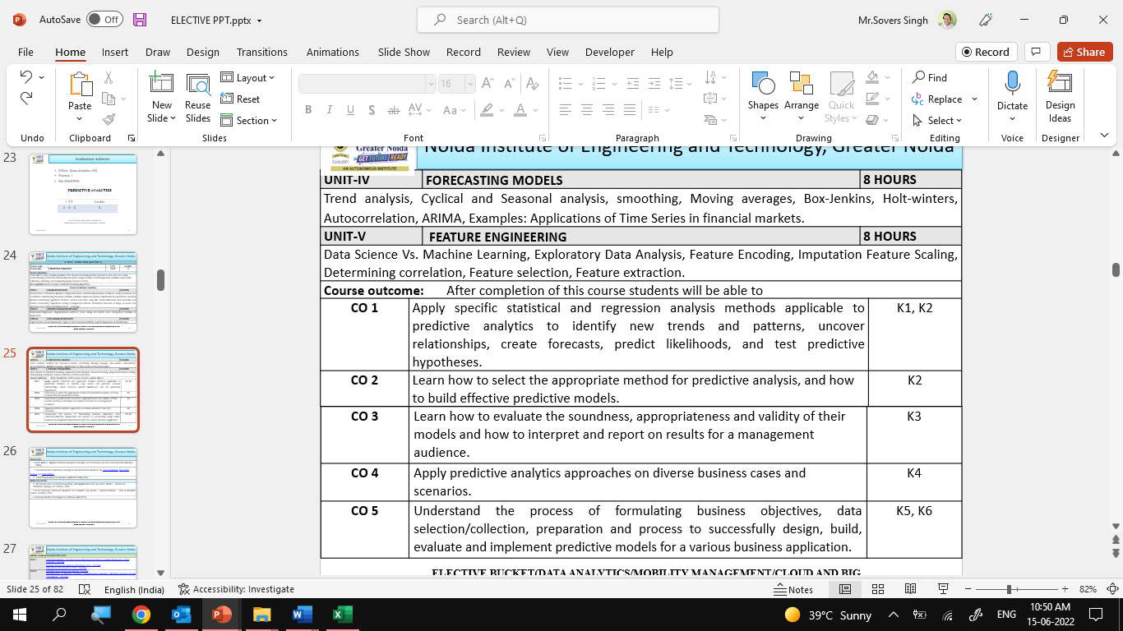

Course Outcomes

Slide 12
Program Outcomes
Engineering Graduates will be able to Understand:
1. Engineering knowledge
2. Problem analysis
3. Design/development of solutions
4. Conduct investigations of complex
5. Modern tool usage
6. The engineer and society
7. Environment and sustainability
8. Ethics
9. Individual and team work
10. Communication
11. Project management and finance
12. Life-long learning

Slide 13
CO-PO Mapping

Slide 14
Program Specific Outcomes (PSOs)
PSO’s
At the end of the program, the student will be able to-
PSO 1: Analyse, design and develop solutions by applying fundamental concepts of Data Science
PSO 2: Apply technical knowledge while using modern tools and technologies for solving complex problems.
PSO 3: Collaborate different fields of science and technology with right attitude, to work as an individual or as a team, demonstrating professional ethics for the well-being of society

Slide 15
COs and PSOs Mapping

Slide 16
Program Educational Objectives (PEOs)
PEO’s
The graduates of B.Tech Data Science program will-
PEO1: Solve real time complex problems and adapt to technological changes with the ability of lifelong learning.
PEO2: Work as data scientists ,entrepreneurs and bureaucrats for goodwill of the society and pursue higher education.
PEO3: Exhibit professional ethics and moral values with good leadership qualities and effective interpersonal skills

Slide 17
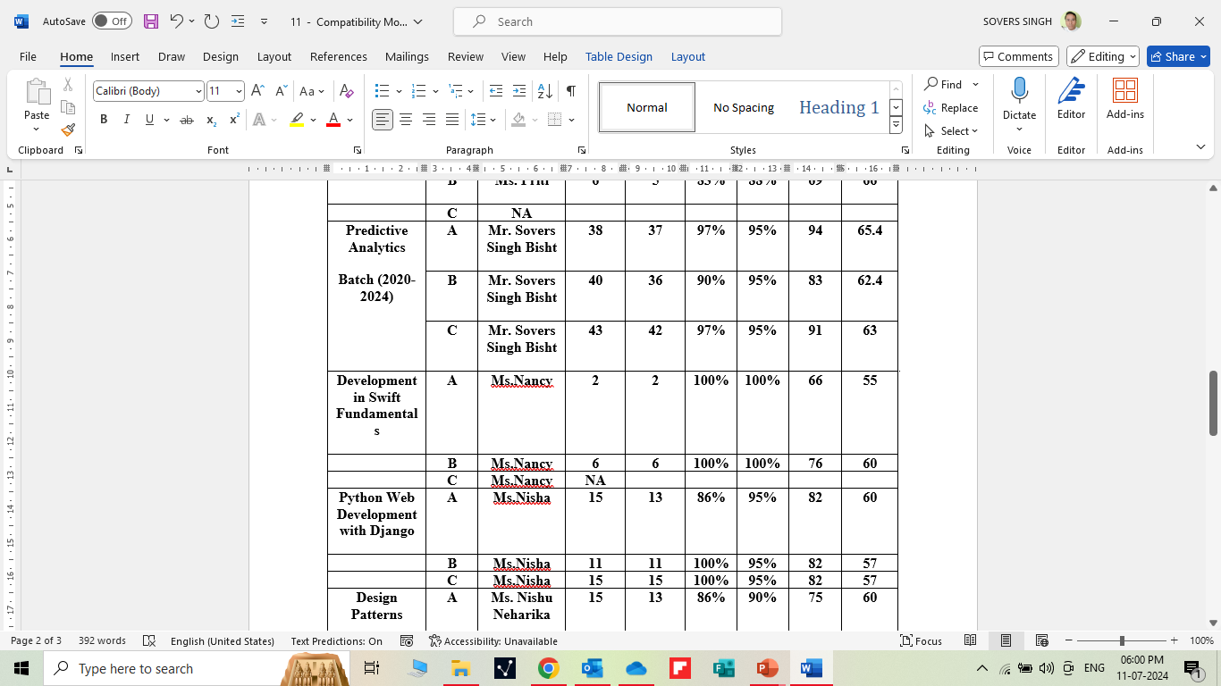
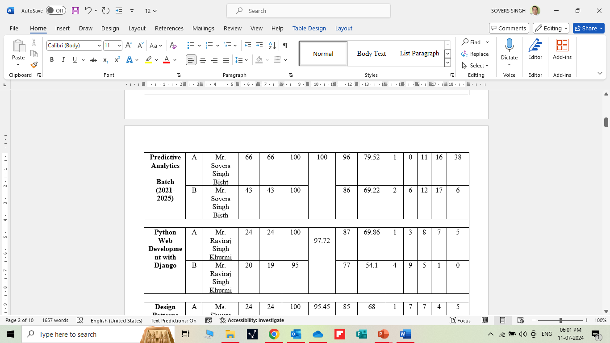
RESULT ANALYSIS

Slide 18

Question Paper Template

Slide 19
Question Paper Template
 |  | SECTION – A |  | CO
 | Attempt all parts- |  | [10×1=10]
 | 1-a. | Question- | (1)
 | 1-b. | Question- | (1)
 | 1-c. | Question- | (1)
 | 1-d. | Question- | (1)
 | 1-e. | Question- | (1)
 | 1-f. | Question- | (1)
 | 1-g. | Question- | (1)
 | 1-h. | Question- | (1)
 | 1-i. | Question- | (1)
 | 1-j. | Question- | (1)
2. | Attempt all parts- |  | [5×2=10] | CO
 | 2-a. | Question- | (2)
 | 2-b. | Question- | (2)
 | 2-c. | Question- | (2)
 | 2-d. | Question- | (2)
 | 2-e. | Question- | (2)
SECTION – B |  |  |  | CO
3. | Answer any five of the following- |  | [5×6=30]
 | 3-a. | Question- | (6)
 | 3-b. | Question- | (6)
 | 3-c. | Question- | (6)
 | 3-d. | Question- | (6)
 | 3-e. | Question- | (6)
 | 3-f. | Question- | (6)
 | 3-g. | Question- | (6)
SECTION – C |  |  |  | CO
4 | Answer any one of the following- |  | [5×10=50]
 | 4-a. | Question- | (10)
 | 4-b. | Question- | (10)
5. | Answer any one of the following-
 | 5-a. | Question- | (10)
 | 5-b. | Question- | (10)
6. | Answer any one of the following-
 | 6-a. | Question- | (10)
 | 6-b. | Question- | (10)
7. | Answer any one of the following-
 | 7-a. | Question- | (10)
 | 7-b. | Question- | (10)
8. | Answer any one of the following-
 | 8-a. | Question- | (10)
 | 8-b. | Question- | (10)

Slide 20
Prerequisite and Recap
Prerequisites:
Linux/ Windows operating system.
Knowledge of basic descriptive statistics and machine learning.
Java & R Studio.
MS Office 2019 and Above.
Programming Languages (Python)
Recap:
Discussion about Data Science Environments.

Slide 21
Brief Intro of Subject with video
Predictive analytics is a form of technology that makes predictions about certain unknowns in the future. It draws on a series of techniques to make these determinations, including artificial intelligence (AI), data mining, machine learning, modeling, and statistics.
For instance, data mining involves the analysis of large sets of data to detect patterns from it. Text analysis does the same, except for large blocks of text.
Predictive models are used for all kinds of applications, including:
Weather forecasts
Creating video games
Translating voice to text for mobile phone messaging
Customer service
Investment portfolio development
https://www.youtube.com/watch?v=4y6fUC56KPw
https://www.youtube.com/watch?v=JOArz7wggkQ

Slide 22
CONTENTS
Feature Engineering:
Data Science Vs. Machine Learning
Exploratory Data Analysis
Feature Encoding
Imputation Feature Scaling
Determining correlation
Feature selection
Feature extraction.

Slide 23
Unit Objective
The objective of the Unit 5 is :
1.To provide an overview of an exciting growing field of data science.
2. To inculcate the preliminary knowledge of handling data , discuss various statistical techniques for handling data.
3. Predictive analytics is a decision-making tool in a variety of industries.
4. Benefits of Feature Engineering
Higher efficiency of the model.
Easier Algorithms that fit the data.
Easier for Algorithms to detect patterns in the data.
Greater Flexibility of the features.

Slide 24
Data Science Vs. Machine Learning
Objective:
In this topic we learn about Data science is the field that studies data and how to extract meaning from it while machine learning focuses on tools and techniques for building models that can learn by themselves by using data
Recap:
Revision of basic statistical approaches.

Slide 25
Data Science Vs. Machine Learning
Data Science Vs. Machine Learning
S.no. | Data Science | Machine Learning
1 | Data Science is a field about processes and systems to extract data from structured and semi-structured data. | Machine Learning is a field of study that gives computers the capability to learn without being explicitly programmed.
2 | Need the entire analytics universe. | Combination of Machine and Data Science.
3 | Branch that deals with data. | Machines utilize data science techniques to learn about the data.
4 | Data in Data Science maybe or maybe not evolved from a machine or mechanical process. | It uses various techniques like regression and supervised clustering.
5 | Data Science as a broader term not only focuses on algorithms statistics but also takes care of the data processing. | But it is only focused on algorithm statistics.
6 | It is a broad term for multiple disciplines. | It fits within data science.
7 | Many operations of data science that is, data gathering, data cleaning, data manipulation, etc. | It is three types: Unsupervised learning, Reinforcement learning, Supervised learning.
8 | Example: Netflix uses Data Science technology. | Example: Facebook uses Machine Learning technology.

Slide 26
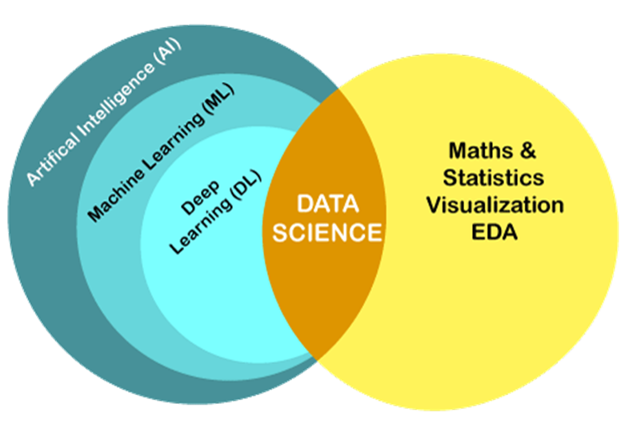
Data Science Vs. Machine Learning

Slide 27
Data Science Vs. Machine Learning
S.no. | Skills Needed for Data Scientists | Skills Needed for Machine Learning Engineers
1 | Statistics | Computer science fundamentals
2 | Data mining and cleaning | Statistical modeling
3 | Data visualization | Data evaluation and modeling
4 | Unstructured data management techniques | Understanding and application of algorithms
5 | Programming languages such as R and Python | Natural language processing
6 | Understand SQL databases | Data architecture design
7 | Use big data tools like Hadoop, Hive and Pig | Text representation techniques

Slide 28
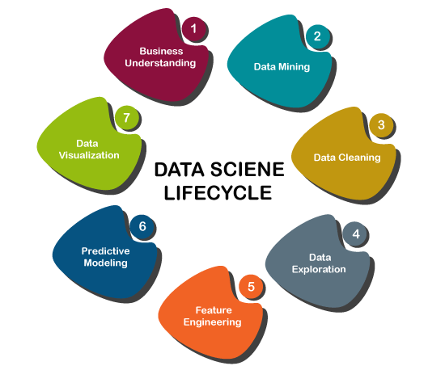
Data Science Vs. Machine Learning

Slide 29
Exploratory Data Analysis
Objective:
In this topic we learn about Exploratory Data Analysis which refers to the critical process of performing initial investigations on data so as to discover patterns, to spot anomalies, to test hypothesis and to check assumptions with the help of summary statistics and graphical representations.
Recap:
Revision of basic statistical approaches.

Slide 30
Exploratory Data Analysis
2. Exploratory Data Analysis
Exploratory Data Analysis (EDA) consists of techniques that are typically applied to gain insight into a dataset before doing any formal modelling.
EDA helps us to uncover the underlying structure of the dataset, identify important variables, detect outliers and anomalies, and test underlying assumptions. With EDA, we identify relevant variables, their transformations, and interaction among variables with respect to the model we want to build. EDA can also point out missing data as may be relevant to building desired models.
EDA uses techniques of statistical graphics but has a broader scope. It's an approach rather than just a set of techniques. “Data Analysis is not “fishing” or “torturing” the data set until it confesses”.
What's the recommended process for doing Exploratory Data Analysis?

Slide 31
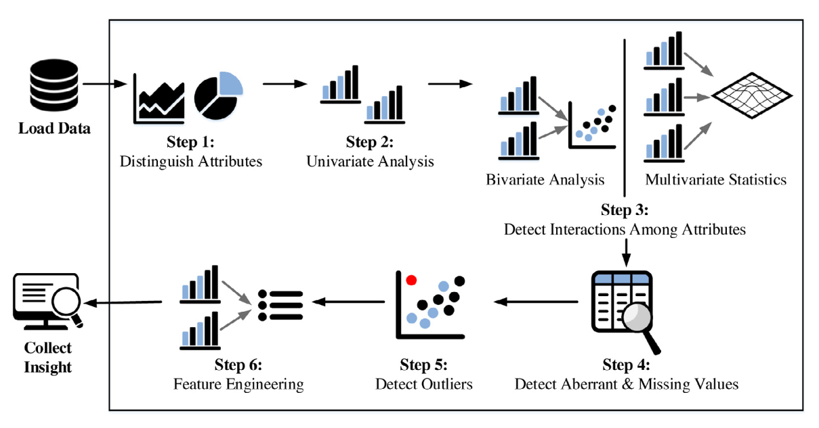
Exploratory Data Analysis
Figure: A typical EDA process

Slide 32

Data transformation and dimensionality reduction techniques such as PCA
Objective:
This topic deals with the concept of Dimensionality reduction which refers to techniques that reduce the number of input variables in a dataset. More input features often make a predictive modeling task more challenging to model, more generally referred to as the curse of dimensionality.
Recap:
Revision R fundamentals.

Slide 33
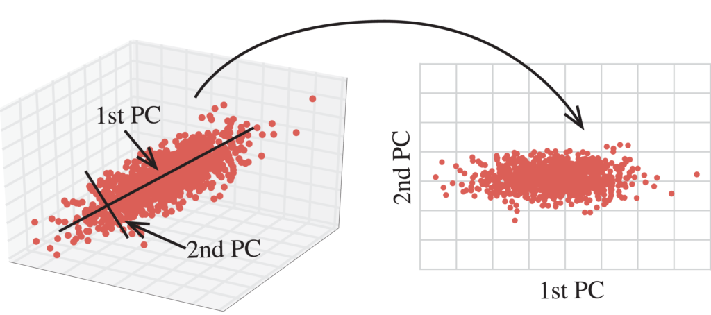
Data transformation and dimensionality reduction techniques such as PCA
Dimensionality Reduction is the process of reducing the dimensions of data without loosing much of information. But is this ever possible? We are reducing dimensions that is we are reducing the importance of certain attributes and we don’t want any loss in the integrity of data!! Yes, it is
Let’s see how we can do this.
Have a glance at the following image

Slide 34
Data transformation and dimensionality reduction techniques such as PCA
Here you can see, in the first image, it is three dimensional data with X,Y, Z axes. The second image is a two dimensional space with PC1, PC2 as axes.
Note these PC1 and PC2 are not our regular dimensions and we cannot name them with any of the previous attribute names. They represent the orthogonal projections along which the variance of data is high. We will understand more about it while dealing with PCA below.
The importance of dimensionality reduction
When we reduce the dimensionality of a dataset, we lose some percentage (usually 1%-15% depending on the number of components or features that we keep) of the variability in the original data. But, don’t worry about losing that much percentage of the variability in the original data because dimensionality reduction will lead to the following advantages.
1. A lower number of dimensions in data means less training time and less computational resources and increases the overall performance of machine learning algorithms — Machine learning problems that involve many features make training extremely slow. Most data points in high-dimensional space are very close to the border of that space. This is because there’s plenty of space in high dimensions. In a high-dimensional dataset, most data points are likely to be far away from each other. Therefore, the algorithms cannot effectively and efficiently train on the high-dimensional data. In machine learning, that kind of problem is referred to as the curse of dimensionality — this is just a technical term that you do not need to worry about!

Slide 35
Data transformation and dimensionality reduction techniques such as PCA
2. Dimensionality reduction is extremely useful for data visualization — When we reduce the dimensionality of higher dimensional data into two or three components, then the data can easily be plotted on a 2D or 3D plot.
3. Dimensionality reduction takes care of multicollinearity — In regression, multicollinearity occurs when an independent variable is highly correlated with one or more of the other independent variables. Dimensionality reduction takes advantage of this and combines those highly correlated variables into a set of uncorrelated variables. This will address the problem of multicollinearity.
4. Dimensionality reduction is very useful for factor analysis — This is a useful approach to find latent variables which are not directly measured in a single variable but rather inferred from other variables in the dataset. These latent variables are called factors.
5. Dimensionality reduction removes noise in the data — By keeping only the most important features and removing the redundant features, dimensionality reduction removes noise in the data. This will improve the model accuracy.

Slide 36
Data transformation and dimensionality reduction techniques such as PCA
6. Dimensionality reduction can be used for image compression — image compression is a technique that minimizes the size in bytes of an image while keeping as much of the quality of the image as possible. The pixels which make the image can be considered as dimensions (columns/variables) of the image data. We perform PCA to keep an optimum number of components that balance the explained variability in the image data and the image quality.
7. Dimensionality reduction can be used to transform non-linear data into a linearly-separable form.

Slide 37
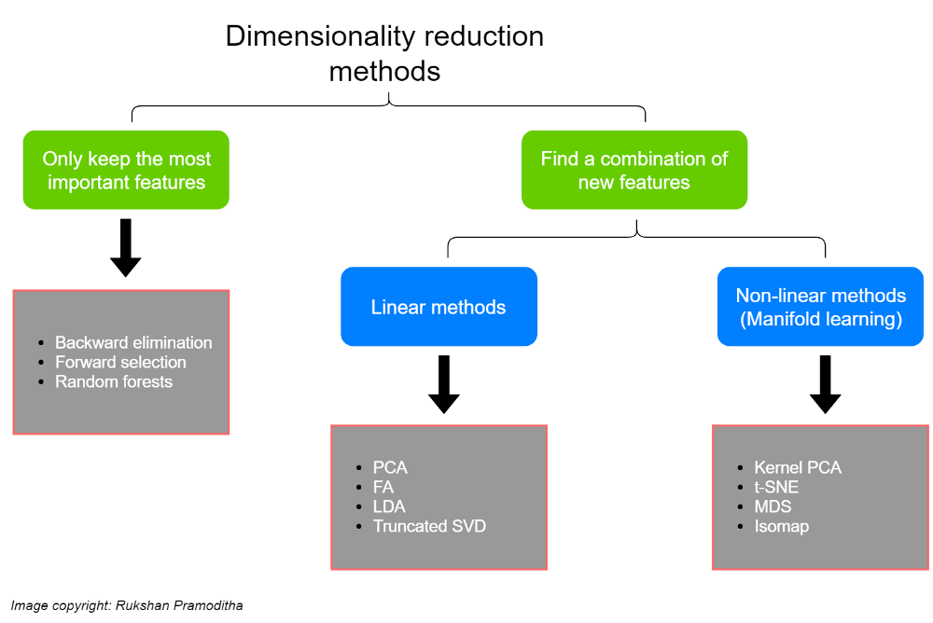
Data transformation and dimensionality reduction techniques such as PCA
Dimensionality reduction methods
There are several dimensionality reduction methods that can be used with different types of data for different requirements. The following chart summarizes those dimensionality reduction methods.

Slide 38
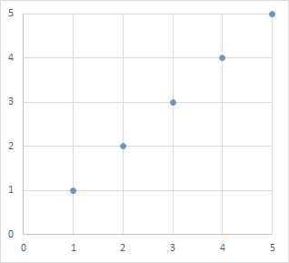
Data transformation and dimensionality reduction techniques such as PCA
Principal component analysis
Principal Component Analysis (PCA) is a statistical procedure that transforms and converts a data set into a new data set containing linearly uncorrelated variables, known as principal components. The basic idea is that the data set is transformed into a set of components where each one attempts to capture as much of the variance (information) in data as possible.
Consider the following data set.

Slide 39
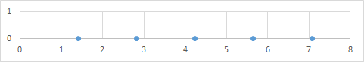
Data transformation and dimensionality reduction techniques such as PCA
This can be transformed, retaining the relationship between the observation, into the following data set—effectively transforming a two-dimensional data set into a one-dimensional data set.
We halved the dimensionality of the data set without sacrificing any of the important information.

Slide 40
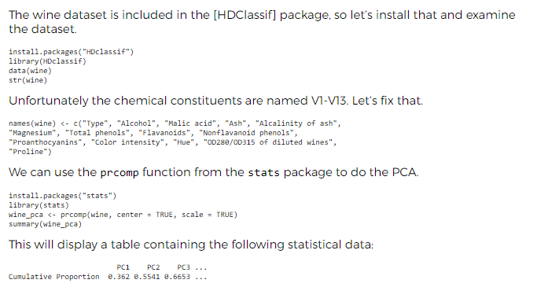
Data transformation and dimensionality reduction techniques such as PCA
PCA using R
Let’s look at how we can conduct PCA using R. We’ll use the Wine Data Set from the UCI Machine Learning Repository. This data set contains the results of chemical analysis of 178 different wines from three cultivars. There observations contain the quantities of 13 constituents found in each of the three types of wines.

Slide 41
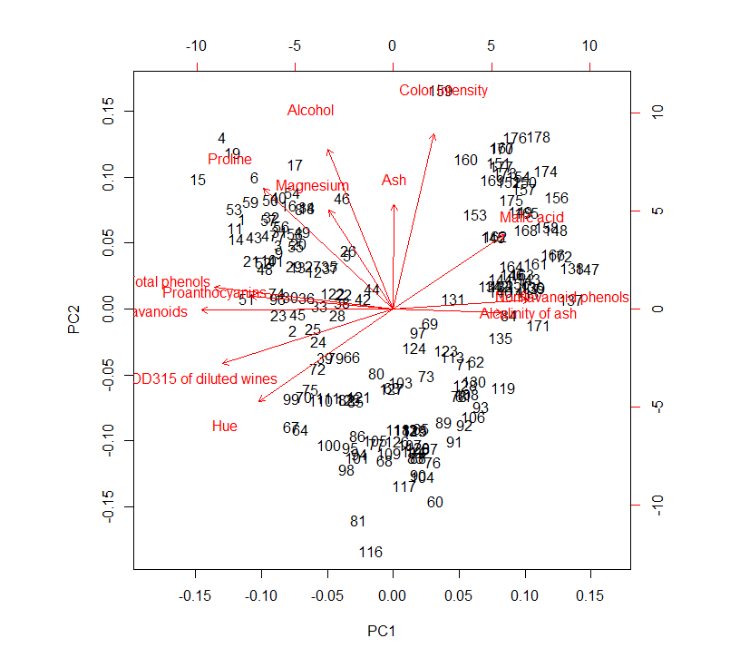
Data transformation and dimensionality reduction techniques such as PCA
What this tells us is that the first two components account for over 55% of the variance in the entire data set. While it would be difficult to justify basing the entire analysis on 55% of the available information, it’s interesting to see that we can account for 55% of the information with 15% of the data.
Visualizing the data set
Let’s visualize the data set using the first two principal components.
biplot(wine_pca)

Slide 42
Data transformation and dimensionality reduction techniques such as PCA
This produces a scatter plot of all the wines. Wines that are close to each other should have similar chemical compositions. We can see wines 4 and 19 at the top left. Let’s compare them.
wine[c(4, 19),]
A quick review will confirm that that are indeed quite similar.
What about the red arrows (vectors) in the diagram? We can hide the wines to make it easier to view these vectors.
biplot(wine_pca, xlabs = rep("", nrow(wine)))

Slide 43
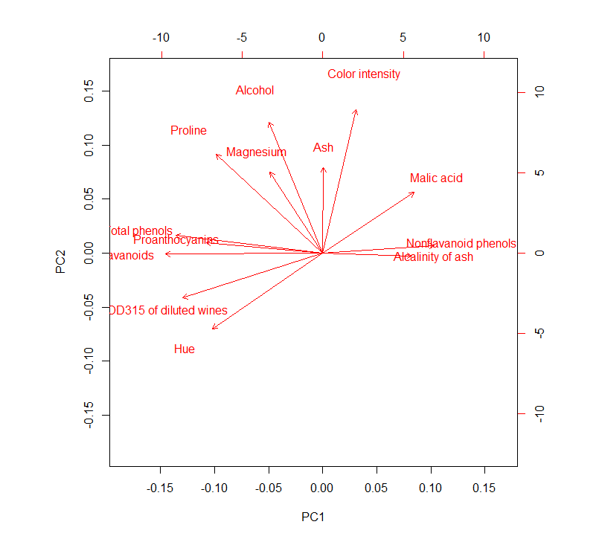
Data transformation and dimensionality reduction techniques such as PCA

Slide 44
Data transformation and dimensionality reduction techniques such as PCA
The vectors show the relationship between the original variables and the principal components. So, “Alcalinity of ash” is similar to PC1. The length of the vector represents the strength of the correlation between the original variable and the principal components.
Variables that are represented by vectors pointing in similar directions have similar meanings. So, “Proanthocyanins” and “Total phenols” seem to represent similar concepts in the context of our significantly reduced data set.
Obviously, this data would require more detailed analysis, but PCA and visualization using biplots are useful tools for getting to grips with high-dimensional data.

Slide 45
Factor analysis and Linear Discriminant Analysis
Objective:
This topic deals with the concept of the R software factor analysis is implemented by the factanal() function of the build-in stats package. The function performs maximum-likelihood factor analysis on a covariance matrix or data matrix.
Recap:
Revision R Programming basics.

Slide 46
Factor analysis and Linear Discriminant Analysis
Viewing Named Objects, Structure of Data
A simple example of factor analysis in R
In the R software factor analysis is implemented by the factanal() function of the build-in stats package. The function performs maximum-likelihood factor analysis on a covariance matrix or data matrix. The number of factors to be fitted is specified by the argument factors. Further, the factor scores may be calculated either by using Thompson’s estimator or Bartlett’s weighted least-squares scores method. The particular method is specified by an additional argument scores = "regression" or scores = "Bartlett". Moreover, by the additional argument rotation the transformation of the factors may be specified by either rotation = "varimax" for orthogonal rotation, rotation = "Bartlett" for oblique rotation or rotation = "none".

Slide 47
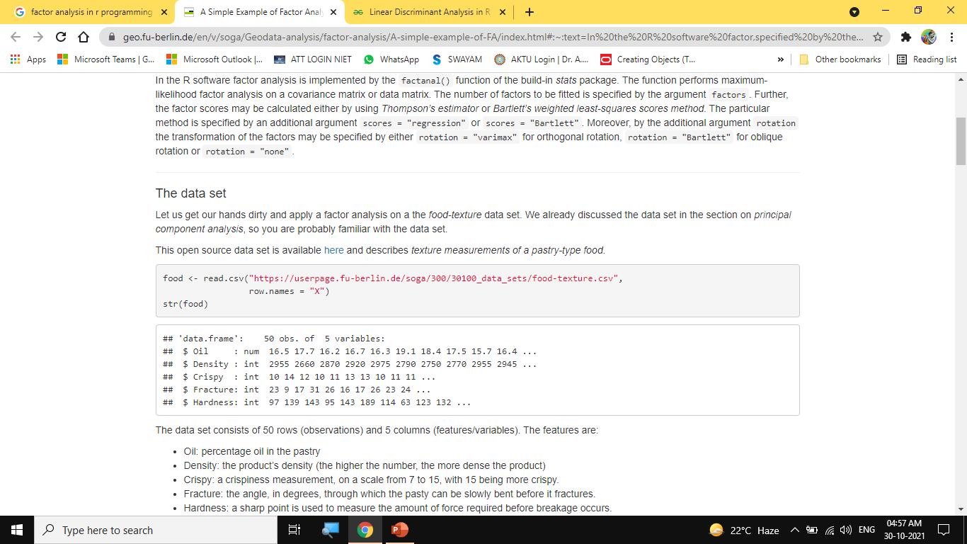
Factor analysis and Linear Discriminant Analysis
Viewing Named Objects, Structure of Data

Slide 48
Factor analysis and Linear Discriminant Analysis
Viewing Named Objects, Structure of Data
The data set consists of 50 rows (observations) and 5 columns (features/variables). The features are:
Oil: percentage oil in the pastry
Density: the product’s density (the higher the number, the more dense the product)
Crispy: a crispiness measurement, on a scale from 7 to 15, with 15 being more crispy.
Fracture: the angle, in degrees, through which the pasty can be slowly bent before it fractures.
Hardness: a sharp point is used to measure the amount of force required before breakage occurs.
The factanal() function call
In addition to the data set the factanal() function requires an estimate of the number of factors (factanal(data, factors = n)). This is a tricky aspect of factor analysis. If we have a hypothesis about the latent variables we may start with an informed guess. If we do not have any clue about the number of factors and the number of variables in the data set is not too large, one may simply try out several values for initializing the model. Another, more sophisticated approach is to use principal components analysis to get a good initial estimate of the number of factors.

Slide 49
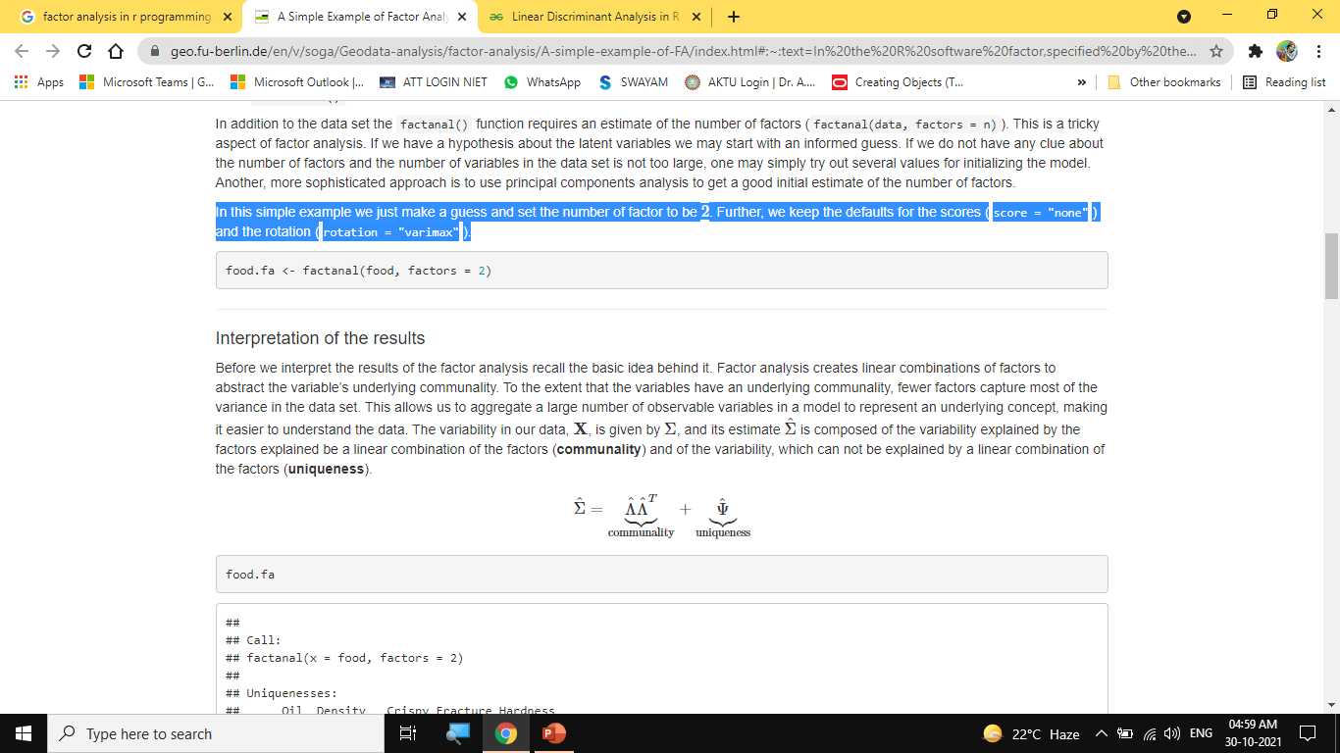
Viewing Named Objects, Structure of Data
Factor analysis and Linear Discriminant Analysis
In this simple example we just make a guess and set the number of factor to be 2. Further, we keep the defaults for the scores (score = "none") and the rotation (rotation = "varimax").

Slide 50

Factor analysis and Linear Discriminant Analysis
Viewing Named Objects, Structure of Data

Slide 51
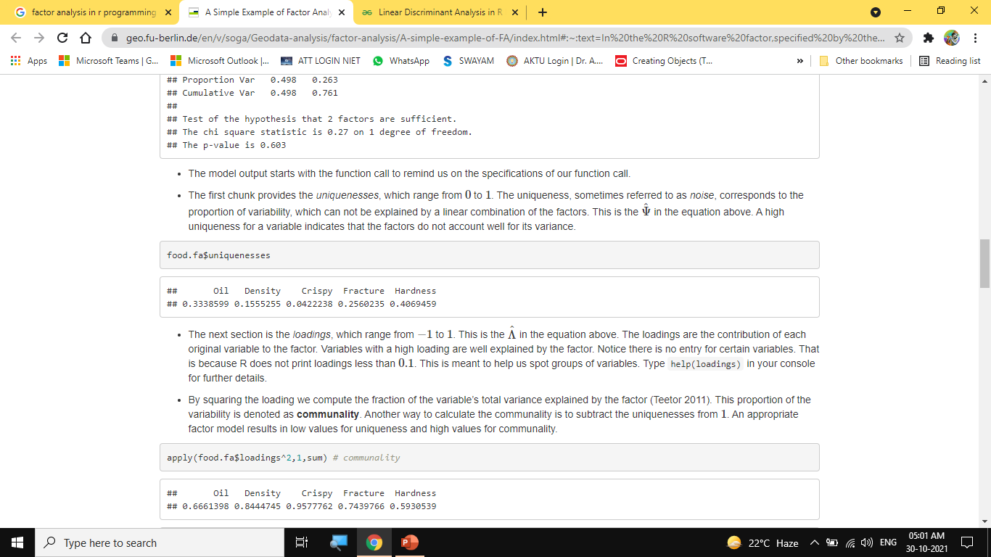
Factor analysis and Linear Discriminant Analysis
Viewing Named Objects, Structure of Data
The model output starts with the function call to remind us on the specifications of our function call.
The first chunk provides the uniquenesses, which range from 0 to 1. The uniqueness, sometimes referred to as noise, corresponds to the proportion of variability, which can not be explained by a linear combination of the factors. This is the Ψ^ in the equation above. A high uniqueness for a variable indicates that the factors do not account well for its variance.

Slide 52
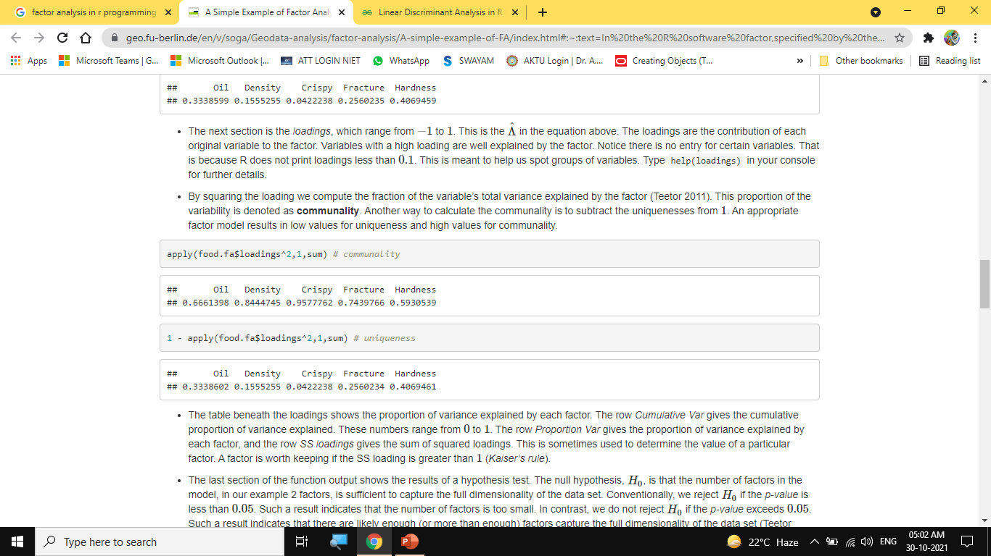
Factor analysis and Linear Discriminant Analysis
Viewing Named Objects, Structure of Data

Slide 53
Factor analysis and Linear Discriminant Analysis
Viewing Named Objects, Structure of Data
The table beneath the loadings shows the proportion of variance explained by each factor. The row Cumulative Var gives the cumulative proportion of variance explained. These numbers range from 0 to 1. The row Proportion Var gives the proportion of variance explained by each factor, and the row SS loadings gives the sum of squared loadings. This is sometimes used to determine the value of a particular factor. A factor is worth keeping if the SS loading is greater than 1 (Kaiser’s rule).
The last section of the function output shows the results of a hypothesis test. The null hypothesis, H0, is that the number of factors in the model, in our example 2 factors, is sufficient to capture the full dimensionality of the data set. Conventionally, we reject H0 if the p-value is less than 0.05. Such a result indicates that the number of factors is too small. In contrast, we do not reject H0 if the p-value exceeds 0.05. Such a result indicates that there are likely enough (or more than enough) factors capture the full dimensionality of the data set (Teetor 2011). The high p-value in our example above leads us to not reject the H0, and indicates that we fitted an appropriate model. This hypothesis test is available thanks to our method of estimation, maximum likelihood. Note that if you provide a covariance matrix to the factanal() function and not a data frame, the hypothesis test is not provided if we do not explicitly provide the number of observations (n.obs) as an additional argument to the function call.

Slide 54
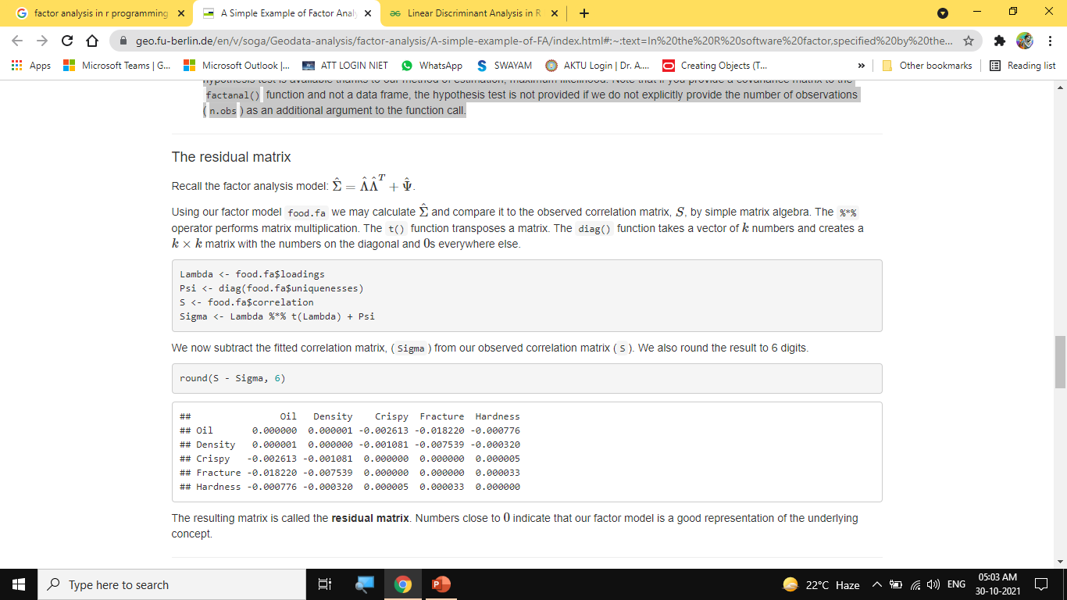
Factor analysis and Linear Discriminant Analysis
Viewing Named Objects, Structure of Data

Slide 55
Factor analysis and Linear Discriminant Analysis
Viewing Named Objects, Structure of Data
Interpretation of the factors
The purpose of a rotation is to produce factors with a mix of high and low loadings and few moderate-sized loadings. The idea is to give meaning to the factors, which helps interpret them. From a mathematical viewpoint, there is no difference between a rotated and unrotated matrix. The fitted model is the same, the uniquenesses are the same, and the proportion of variance explained is the same.
Let us fit three factor models, one with no rotation, one with varimax rotation, and one with promax rotation, and make a scatter plot of the first and second loadings.

Slide 56
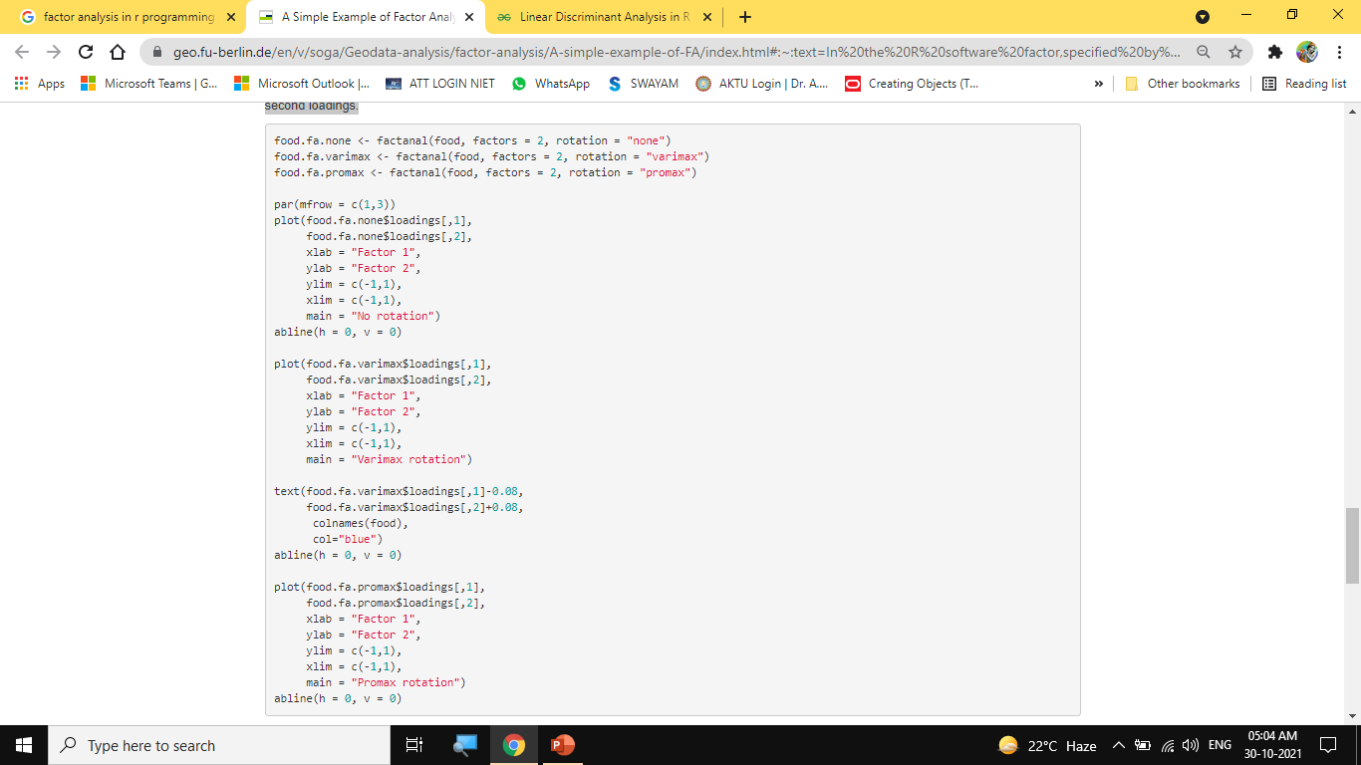
Factor analysis and Linear Discriminant Analysis
Viewing Named Objects, Structure of Data

Slide 57
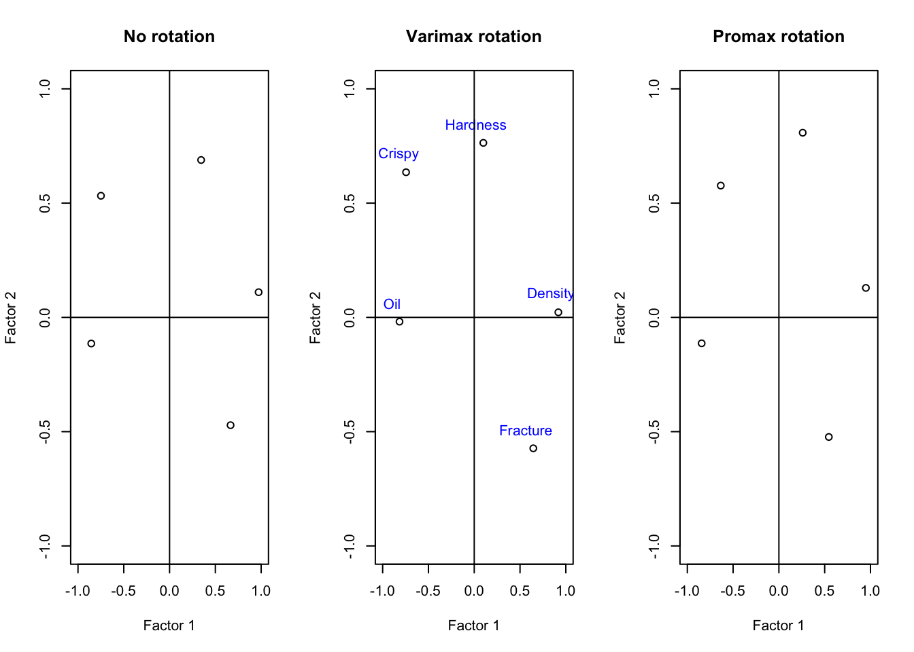
Factor analysis and Linear Discriminant Analysis
Viewing Named Objects, Structure of Data

Slide 58
Factor analysis and Linear Discriminant Analysis
Viewing Named Objects, Structure of Data
Now comes the tricky aspect in factor analysis: Interpreting the factors themselves. If two variables both have large loadings for the same factor, then we know they have something in common. As a researcher we have to understand the data and its meaning in order to give a name to that common ground. Taking a look on the figures above is appears that factor 1 accounts for pastry, which is dense and can be bend a lot before it breaks. Whereas factor 2 accounts for pastry that crispy and hard to break apart. So if we need to names these factors we would probably call them soft pastry (factor 1) and hard pastry (factor 2).

Slide 59
Factor analysis and Linear Discriminant Analysis
Viewing Named Objects, Structure of Data
Linear Discriminant Analysis in R Programming
One of the most popular or well established Machine Learning technique is Linear Discriminant Analysis (LDA ). It is mainly used to solve classification problems rather than supervised classification problems. It is basically a dimensionality reduction technique. Using the Linear combinations of predictors, LDA tries to predict the class of the given observations. Let us assume that the predictor variables are p. Let all the classes have an identical variant (i.e. for univariate analysis the value of p is 1) or identical covariance matrices (i.e. for multivariate analysis the value of p is greater than 1).
Method of implementing LDA in R
LDA or Linear Discriminant Analysis can be computed in R using the lda() function of the package MASS. LDA is used to determine group means and also for each individual, it tries to compute the probability that the individual belongs to a different group. Hence, that particular individual acquires the highest probability score in that group.
To use lda() function, one must install the following packages:
MASS package for lda() function.
tidyverse package for better and easy data manipulation and visualization.
caret package for a better machine learning workflow.

Slide 60
Factor analysis and Linear Discriminant Analysis
Viewing Named Objects, Structure of Data
On installing these packages then prepare the data. To prepare data, at first one needs to split the data into train set and test set. Then one needs to normalize the data. On doing so, automatically the categorical variables are removed. Once the data is set and prepared, one can start with Linear Discriminant Analysis using the lda() function.
At first, the LDA algorithm tries to find the directions that can maximize the separation among the classes. Then it uses these directions for predicting the class of each and every individual. These directions are known as linear discriminants and are a linear combinations of the predictor variables.

Slide 61
Factor analysis and Linear Discriminant Analysis
Viewing Named Objects, Structure of Data
Explanation of the function lda()
Before implementing the linear discriminant analysis, let us discuss the things to consider:
One needs to inspect the univariate distributions of each and every variable. It must be normally distributed. If not, then transform using either the log and root function for exponential distribution or the Box-Cox method for skewed distribution.
One needs to remove the outliers of the data and then standardize the variables in order to make the scale comparable.
Let us assume that the dependent variable i.e. Y is discrete.
LDA assumes that the predictors are normally distributed i.e. they come from gaussian distribution. Various classes have class specific means and equal covariance or variance.
Under the MASS package, we have the lda() function for computing the linear discriminant analysis. Let’s see the default method of using the lda() function.

Slide 62
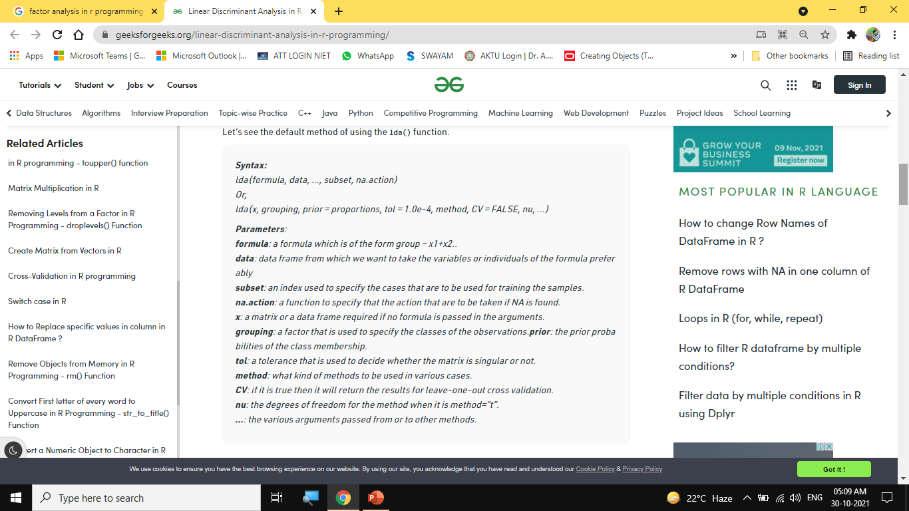
Factor analysis and Linear Discriminant Analysis
Viewing Named Objects, Structure of Data

Slide 63
Factor analysis and Linear Discriminant Analysis
Viewing Named Objects, Structure of Data
The function lda() has the following elements in it’s output:
Prior possibilities of groups i.e. in each and every group the proportion of the training observations.
Group means i.e. the group’s center of gravity and is used to show in a group the mean of each and every variable.
Coefficients of linear discriminants i.e the linear combination of the predictor variables which are used to form the decision rule of LDA.
Example:
Let us see how Linear Discriminant Analysis is computed using the lda() function. Let’s use the iris data set of R Studio.

Slide 64

Factor analysis and Linear Discriminant Analysis
Viewing Named Objects, Structure of Data

Slide 65
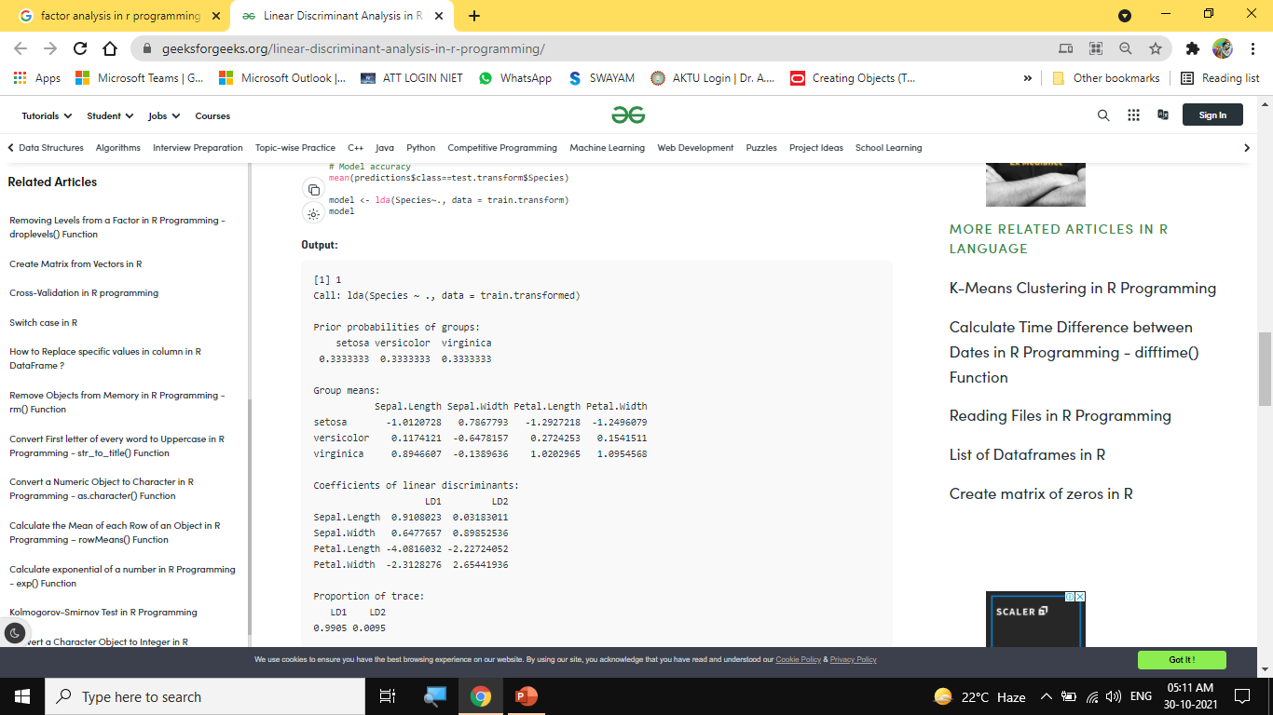
Factor analysis and Linear Discriminant Analysis
Viewing Named Objects, Structure of Data

Slide 66
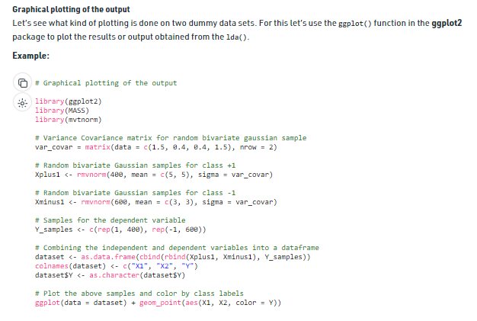
Factor analysis and Linear Discriminant Analysis
Viewing Named Objects, Structure of Data

Slide 67
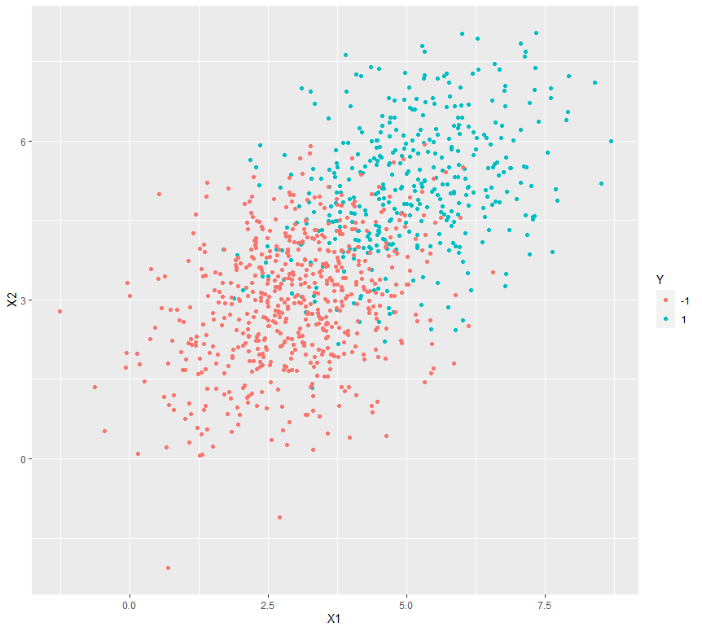
Factor analysis and Linear Discriminant Analysis
Viewing Named Objects, Structure of Data
Output:
Applications
1. In Face Recognition System, LDA is used to generate a more reduced and manageable number of features before classifications.
2. In Customer Identification System, LDA helps to identify and choose the features which can be used to describe the characteristics or features of a group of customers who can buy a particular item or product from a shopping mall.
3. In field of Medical Science, LDA helps to identify the features of various diseases and classify it as mild or moderate or severe based on the patient’s symptoms.

Slide 68
Univariate and Multivariate Exploratory Data Analysis.
Objective:
This topic deals with the concept of Univariate involves the analysis of a single variable while multivariate analysis examines two or more variables. Most multivariate analysis involves a dependent variable and multiple independent variables.
Recap:
Revision R programming basics.

Slide 69
Univariate and Multivariate Exploratory Data Analysis.
Exploratory Analysis Using Univariate, Bivariate, and Multivariate Analysis Techniques
Introduction
Data is everywhere around us, in spreadsheets, on various social media platforms, in survey forms, and more. The process of cleaning, transforming, interpreting, analyzing, and visualizing this data to extract useful information and gain valuable insights to make more effective business decisions is called Data Analysis.
Data Analysis can be organized into 6 types
Exploratory Analysis
Descriptive Analysis
Inferential Analysis
Predictive Analysis
Causal Analysis
Mechanistic Analysis

Slide 70
Univariate and Multivariate Exploratory Data Analysis.
Exploratory Analysis
The preliminary analysis of data to discover relationships between measures in the data and to gain an insight on the trends, patterns, and relationships among various entities present in the data set with the help of statistics and visualization tools is called Exploratory Data Analysis (EDA).
Exploratory data analysis is cross-classified in two different ways where each method is either graphical or non-graphical. And then, each method is either univariate, bivariate or multivariate.
Univariate Analysis
Uni means one and variate means variable, so in univariate analysis, there is only one dependable variable. The objective of univariate analysis is to derive the data, define and summarize it, and analyze the pattern present in it. In a dataset, it explores each variable separately. It is possible for two kinds of variables- Categorical and Numerical.
Some patterns that can be easily identified with univariate analysis are Central Tendency (mean, mode and median), Dispersion (range, variance), Quartiles (interquartile range), and Standard deviation.
Univariate data can be described through:

Slide 71
Univariate and Multivariate Exploratory Data Analysis.
Ø Frequency Distribution Tables
The frequency distribution table reflects how often an occurrence has taken place in the data. It gives a brief idea of the data and makes it easier to find patterns.
Example:
The list of IQ scores is: 118, 139, 124, 125, 127, 128, 129, 130, 130, 133, 136, 138, 141, 142, 149, 130, 154.
IQ Range Number
118-125 3
126-133 7
134-141 4
142-149 2
150-157 1

Slide 72
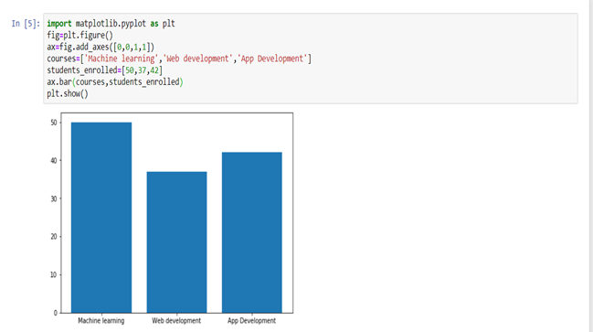
Univariate and Multivariate Exploratory Data Analysis.
Ø Bar Charts
The bar graph is very convenient while comparing categories of data or different groups of data. It helps to track changes over time. It is best for visualizing discrete data.

Slide 73
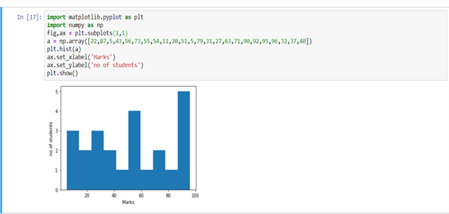
Univariate and Multivariate Exploratory Data Analysis.
Ø Histograms
Histograms are similar to bar charts and display the same categorical variables against the category of data. Histograms display these categories as bins which indicate the number of data points in a range. It is best for visualizing continuous data.

Slide 74
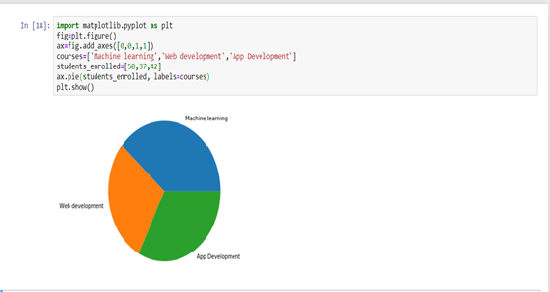
Univariate and Multivariate Exploratory Data Analysis.
Ø Pie Charts
Pie charts are mainly used to comprehend how a group is broken down into smaller pieces. The whole pie represents 100 percent, and the slices denote the relative size of that particular category.

Slide 75
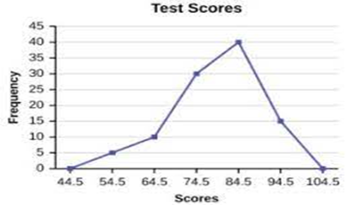
Univariate and Multivariate Exploratory Data Analysis.
Ø Frequency Polygons
Similar to histograms, a frequency polygon is used for comparing datasets or displaying the cumulative frequency distribution.

Slide 76
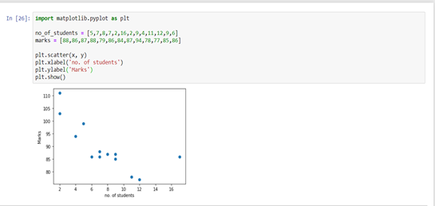
Univariate and Multivariate Exploratory Data Analysis.
Bivariate Analysis
Bi means two and variate means variable, so here there are two variables. The analysis is related to cause and the relationship between the two variables. There are three types of bivariate analysis.
Bivariate Analysis of two Numerical Variables (Numerical-Numerical)
Ø Scatter Plot
A scatter plot represents individual pieces of data using dots. These plots make it easier to see if two variables are related to each other. The resulting pattern indicates the type (linear or non-linear) and strength of the relationship between two variables.

Slide 77
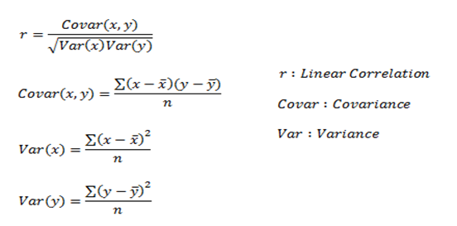
Univariate and Multivariate Exploratory Data Analysis.
Ø Linear Correlation
Linear Correlation represents the strength of a linear relationship between two numerical variables. If there is no correlation between the two variables, there is no tendency to change along with the values of the second quantity.

Slide 78
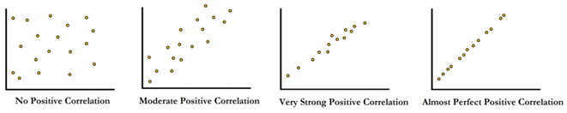
Univariate and Multivariate Exploratory Data Analysis.
Here, r measures the strength of a linear relationship and is always between -1 and 1 where -1 denotes perfect negative linear correlation and +1 denotes perfect positive linear correlation and zero denotes no linear correlation.

Slide 79
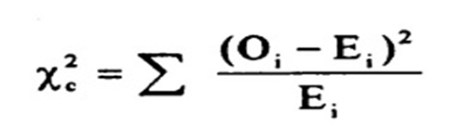
Univariate and Multivariate Exploratory Data Analysis.
Bivariate Analysis of two categorical Variables (Categorical-Categorical)
Ø Chi-square Test
The chi-square test is used for determining the association between categorical variables. It is calculated based on the difference between expected frequencies and the observed frequencies in one or more categories of the frequency table. A probability of zero indicates a complete dependency between two categorical variables and a probability of one indicates that two categorical variables are completely independent.
Here, subscript c indicates the degrees of freedom, O indicates observed value, and E indicates expected value.

Slide 80
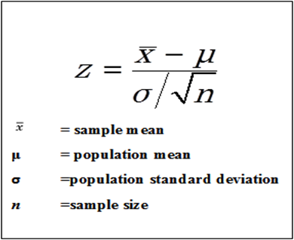
Univariate and Multivariate Exploratory Data Analysis.
Bivariate Analysis of one numerical and one categorical variable (Numerical-Categorical)
Ø Z-test and t-test
Z and T-tests are important to calculate if the difference between a sample and population is substantial.
If the probability of Z is small, the difference between the two averages is more significant.

Slide 81
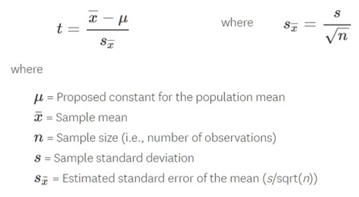
Univariate and Multivariate Exploratory Data Analysis.
T-Test
If the sample size is large enough, then we use a Z-test, and for a small sample size, we use a T-test.

Slide 82
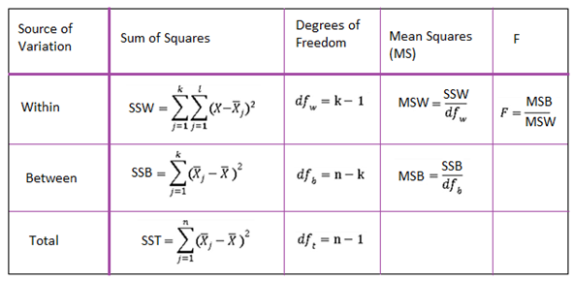
Univariate and Multivariate Exploratory Data Analysis.
Ø ANALYSIS OF VARIANCE (ANOVA)
The ANOVA test is used to determine whether there is a significant difference among the averages of more than two groups that are statistically different from each other. This analysis is appropriate for comparing the averages of a numerical variable for more than two categories of a categorical variable.

Slide 83
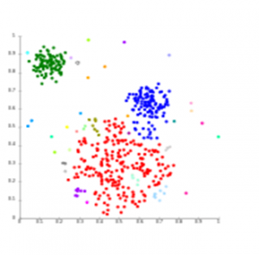
Univariate and Multivariate Exploratory Data Analysis.
Multivariate Analysis
Multivariate analysis is required when more than two variables have to be analyzed simultaneously. It is a tremendously hard task for the human brain to visualize a relationship among 4 variables in a graph and thus multivariate analysis is used to study more complex sets of data. Types of Multivariate Analysis include Cluster Analysis, Factor Analysis, Multiple Regression Analysis, Principal Component Analysis, etc. More than 20 different ways to perform multivariate analysis exist and which one to choose depends upon the type of data and the end goal to achieve. The most common ways are:
Ø Cluster Analysis
Cluster Analysis classifies different objects into clusters in a way that the similarity between two objects from the same group is maximum and minimal otherwise. It is used when rows and columns of the data table represent the same units and the measure represents distance or similarity.

Slide 84
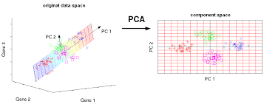
Univariate and Multivariate Exploratory Data Analysis.
Ø Principal Component Analysis (PCA)
Principal Components Analysis (or PCA) is used for reducing the dimensionality of a data table with a large number of interrelated measures. Here, the original variables are converted into a new set of variables, which are known as the “Principal Components” of Principal Component Analysis.
PCA is used for the dataset that shows multicollinearity. Although least squares estimates are biased, the distance between variances and their actual value can be really large. So, PCA adds some bias and reduces standard error for the regression model.

Slide 85
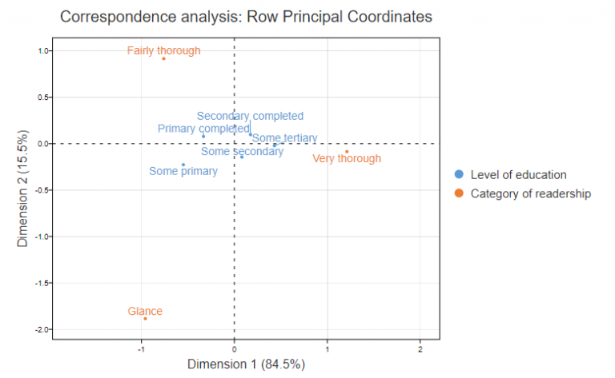
Univariate and Multivariate Exploratory Data Analysis.
Ø Correspondence Analysis
Correspondence Analysis using the data from a contingency table shows relative relationships between and among two different groups of variables. A contingency table is a 2D table with rows and columns as groups of variables.

Slide 86
Feature Encoding
Objective:
In this topic we learn about Feature encoding which is the process of turning categorical data in a dataset into numerical data. It is essential that we perform feature encoding because most machine learning models can only interpret numerical data and not data in text form.
Recap:
Revision of basic statistical approaches.

Slide 87
Feature Encoding
Feature encoding
Machine learning models can only work with numerical values. For this reason, it is necessary to transform the categorical values of the relevant features into numerical ones. This process is called feature encoding.
Data frame analytics automatically performs feature encoding. The input data is pre-processed with the following encoding techniques:
• one-hot encoding: Assigns vectors to each category. The vector represent whether the corresponding feature is present (1) or not (0).
• target-mean encoding: Replaces categorical values with the mean value of the target variable.
• frequency encoding: Takes into account how many times a given categorical value is present in relation with a feature.
When the model makes predictions on new data, the data needs to be processed in the same way it was trained. Machine learning model inference in the Elastic Stack does this automatically, so the automatically applied encodings are used in each call for inference. Refer to inference for classification and regression.
Feature importance is calculated for the original categorical fields, not the automatically encoded features.

Slide 88
Imputation Feature Scaling
Objective:
In this topic we learn about Imputation is the act of replacing missing data with statistical estimates of the missing values. The goal of any imputation technique is to produce a **complete dataset** that can be used to train machine learning models.
Recap:
Revision of basic statistical approaches.

Slide 89
Data Preprocessing– Attribute and its types Understanding and extracting useful variables.
Objective:
This topic deals with the concept of Data preprocessing which is the initial phase of Machine Learning where data is prepared for machine learning models. This part is crucial and needs to be performed properly and systematically. If not, we will end up building models that are not accurate for their purpose.
Recap:
Revision R Programming basics.

Slide 90
Data Preprocessing– Attribute and its types Understanding and extracting useful variables.
Data Extraction in R
In data extraction, the initial step is data pre-processing or data cleaning. In data cleaning, the task is to transform the dataset into a basic form that makes it easy to work with. One characteristic of a clean/tidy dataset is that it has one observation per row and one variable per column.
The next step in data extraction is data manipulation. In data manipulation, the task is to modify the data to make it easier to read and more organized. We manipulate the data for data analysis and data visualization. Data manipulation is also used with the term ‘data exploration’ which involves organizing data using the available sets of variables.
At times, the data collection process done by machines involves lots of errors and inaccuracies in reading. Data manipulation is also used to remove these inaccuracies and make data more accurate and precise.
Exploring Raw Data
Raw data is data collected from a source, which has not yet been processed for usage. Typically, the readily available data is not in a state in which it can be used efficiently for data extraction. Such data is difficult to manipulate and often needs to be processed in some way, before it can be used for data analysis and data extraction in general, and is referred to as raw data or source data.

Slide 91
Data Preprocessing– Attribute and its types Understanding and extracting useful variables.
To import the dataset:
census <- read.csv("C:\\Users\\Team\\Desktop\\census-income.csv")
To understand the structure of the dataset, we often use the following functions in R Programming:
a) class() – class of data object
b) str() – compact display of the internal structure of data
c) summary() – summary of data
d) names() – column names
e) dim() – dimensions of data
f) head() – view of the data from the top
g) tail() – view of the data from the bottom

Slide 92
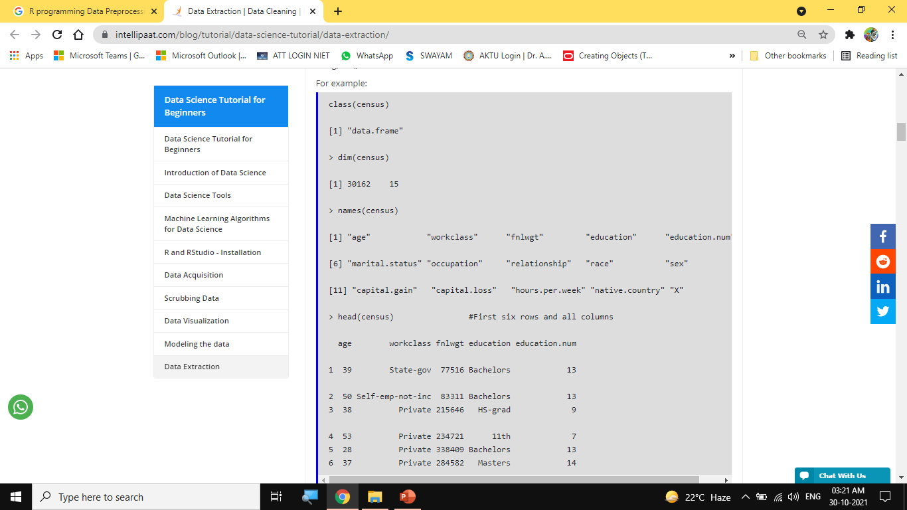
Data Preprocessing– Attribute and its types Understanding and extracting useful variables.

Slide 93
Data Preprocessing– Attribute and its types Understanding and extracting useful variables.
Removing Leading and Trailing Whitespaces
While dealing with character columns in a dataset, there can be situations where there are whitespaces at the beginning and/or end of the strings. These whitespaces can cause issues when attempting to perform data extraction and various operations such as sorting, sub-setting, etc.
In this blog, we will use various functions from the stringr and the dplyr packages to remove any whitespaces from the columns.
If the whitespaces exist in a factor column that contains characters, then we first need to convert the factor columns to character columns before we can remove those whitespaces. After the whitespaces are removed, we can convert those columns back to factors. Studying the Machine Learning Course will give you a better insight on the project.
For example:
In the ‘census’ dataset, the factor columns that contain whitespaces are first converted to character columns before removing the whitespaces.

Slide 94
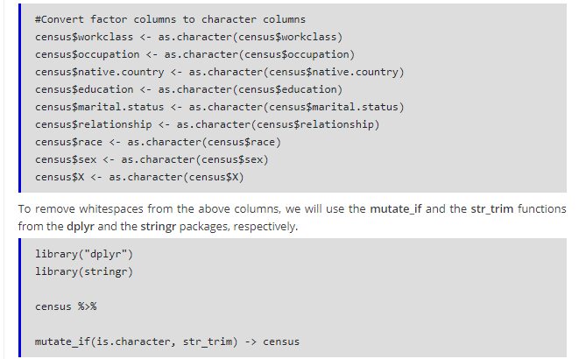
Data Preprocessing– Attribute and its types Understanding and extracting useful variables.

Slide 95
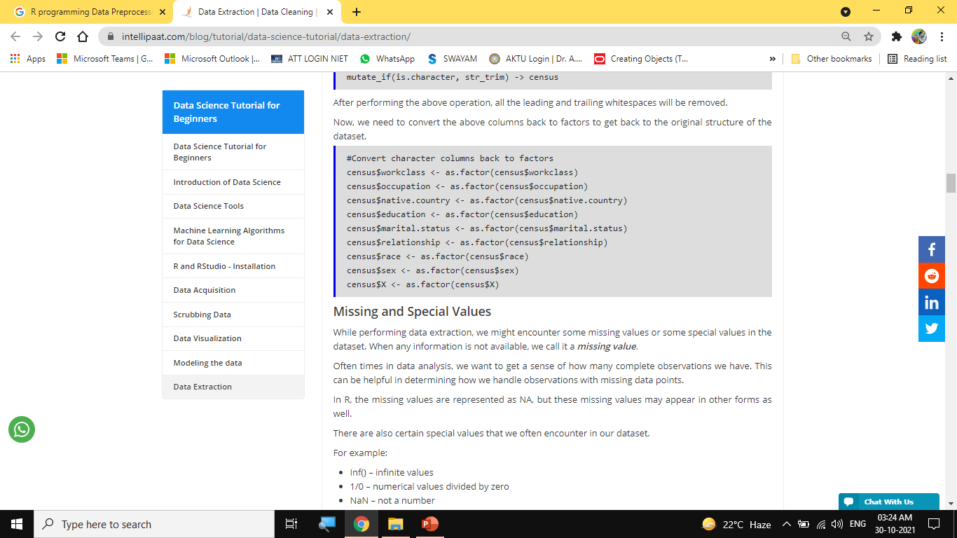
Data Preprocessing– Attribute and its types Understanding and extracting useful variables.

Slide 96
Data Preprocessing– Attribute and its types Understanding and extracting useful variables.
Missing and Special Values
While performing data extraction, we might encounter some missing values or some special values in the dataset. When any information is not available, we call it a missing value.
Often times in data analysis, we want to get a sense of how many complete observations we have. This can be helpful in determining how we handle observations with missing data points.
In R, the missing values are represented as NA, but these missing values may appear in other forms as well.
There are also certain special values that we often encounter in our dataset.
For example:
Inf() – infinite values
1/0 – numerical values divided by zero
NaN – not a number
0/0 – zero divided by zero

Slide 97
Data Preprocessing– Attribute and its types Understanding and extracting useful variables.
To find missing values in a data frame, we can use the following functions:
is.na() – indicates which elements are missing
any(is.na()) – indicates if there are any NAs
sum(is.na()) – counts the number of NAs
summary() – finds NAs
To deal with NAs, we can use the following functions:
complete.cases() – to find rows with no missing values
na.omit() – to remove rows with NAs

Slide 98
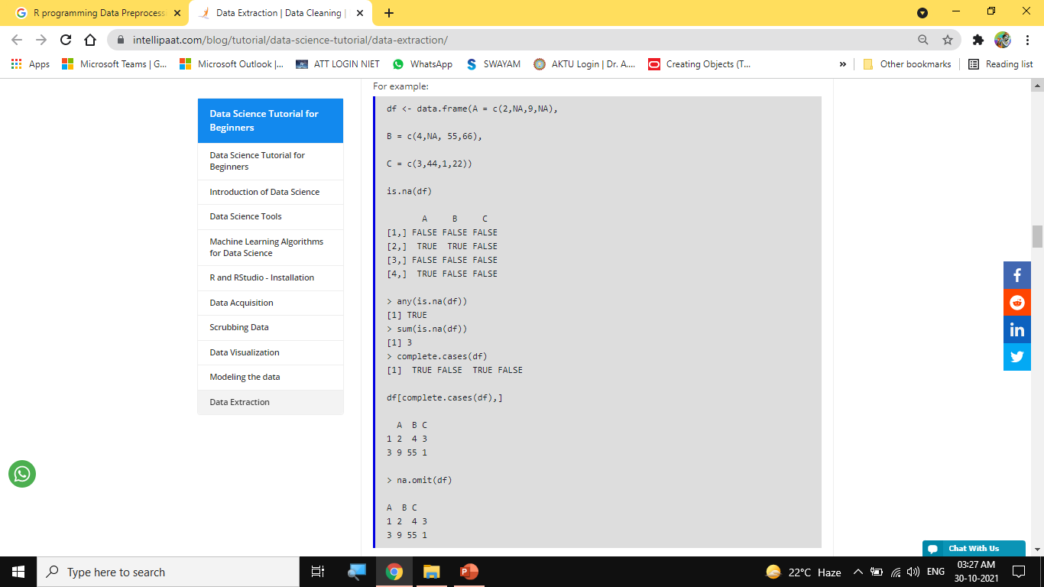
Data Preprocessing– Attribute and its types Understanding and extracting useful variables.

Slide 99
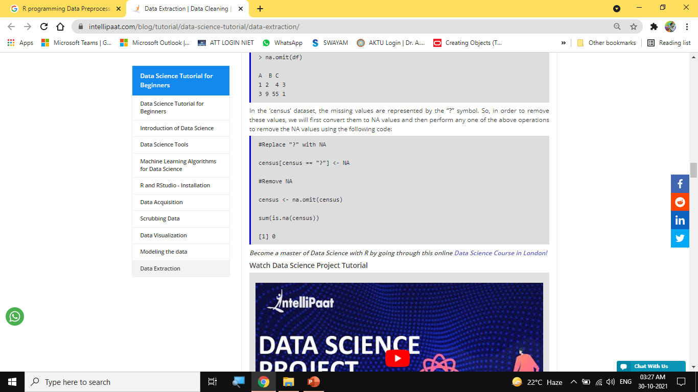
Data Preprocessing– Attribute and its types Understanding and extracting useful variables.

Slide 100
Data Preprocessing– Attribute and its types Understanding and extracting useful variables.
Data Extraction in R
After completing the data cleaning step, our data is now in a clean and tidy format that can be used to perform data extraction and data analysis.
First, we will use the base R functions to extract rows and columns from a data frame. While performing data analysis or working on Data Science projects, these commands come in handy to extract information from a dataset.
In this blog, we will use the indexing features in R to perform data extraction on the ‘census’ dataset.

Slide 101
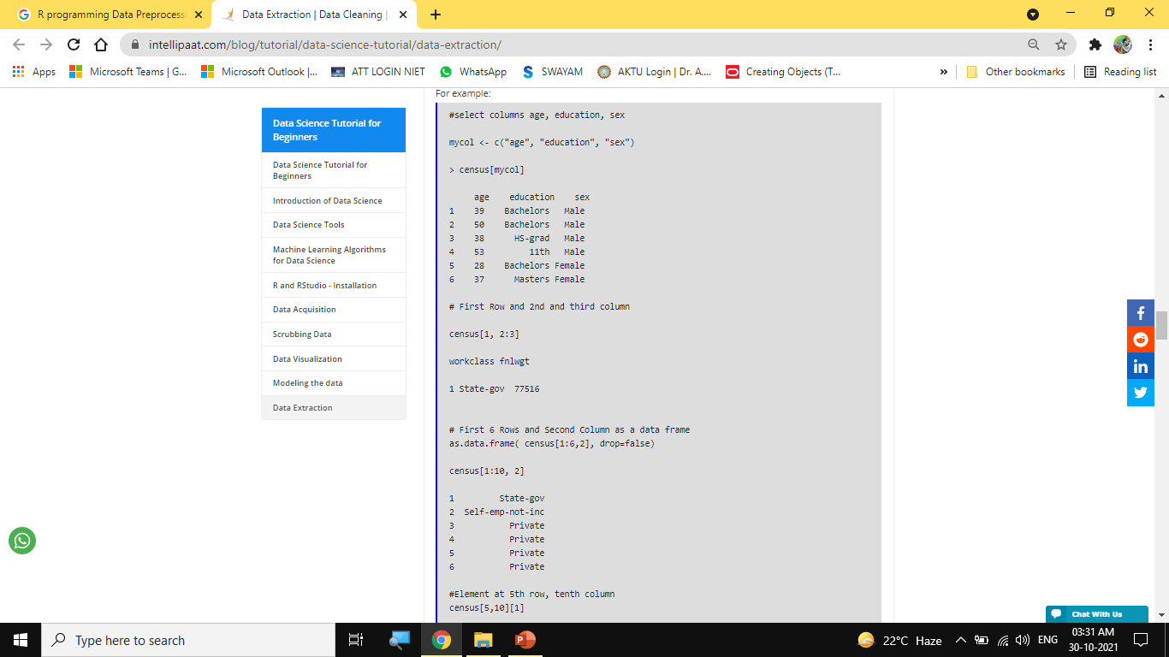
Data Preprocessing– Attribute and its types Understanding and extracting useful variables.

Slide 102
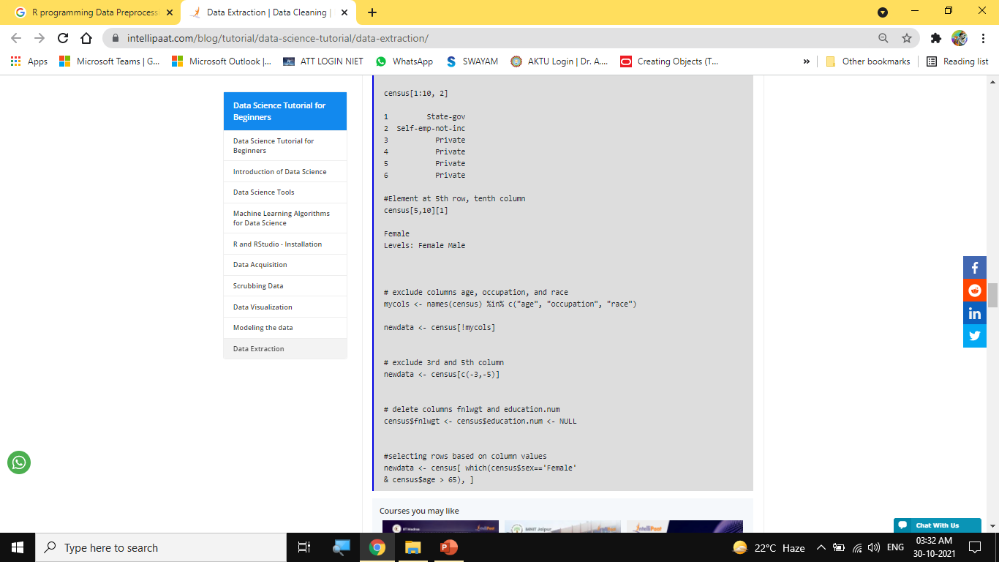
Data Preprocessing– Attribute and its types Understanding and extracting useful variables.

Slide 103
Data Preprocessing– Attribute and its types Understanding and extracting useful variables.
Subset Function
We can also use the subset() function from the base R package to select variables and observations.
#selecting rows where age is either greater than 50 or less than 20, and only age and education columns.
newdata <- subset(census, age >= 50 | age < 20, select=c(age, education))
#selecting rows where education is Bachelors and Yearly Income(X) is >50K, and only education and capital.gain column.
> newdata <- subset(census, education == "Bachelors" & X == ">50K", select = c(education, capital.gain))
> head(newdata)
education capital.gain
10 Bachelors 5178
12 Bachelors 0
26 Bachelors 0
46 Bachelors 0
54 Bachelors 0
73 Bachelors 0

Slide 104
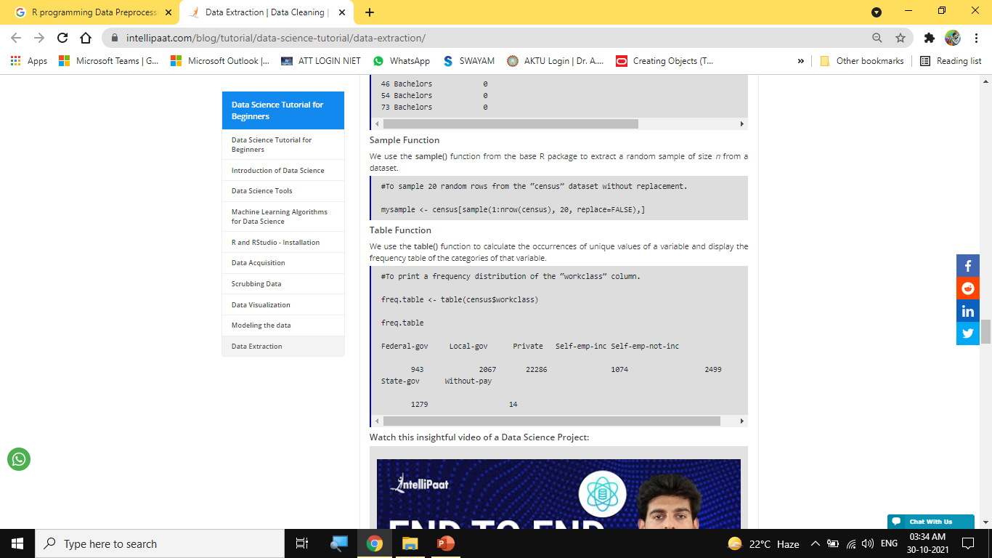
Data Preprocessing– Attribute and its types Understanding and extracting useful variables.

Slide 105
Data Preprocessing– Attribute and its types Understanding and extracting useful variables.
Data Extraction in R with dplyr
The dplyr package contains various functions that are specifically designed for data extraction and data manipulation. These functions are preferred over the base R functions because the former process data at a faster rate and are known as the best for data extraction, exploration, and transformation.
Some of the important functions for data manipulation in R are as follows:
select(): to select columns (variables)
filter(): to filter (subset) rows
mutate(): to create new columns
summarise(): to summarize (or aggregate) data
group_by(): to group data
arrange(): to sort data
join(): to join data frames
Now, let’s explore some examples of data extraction on the ‘census’ dataset using the dplyr package.

Slide 106
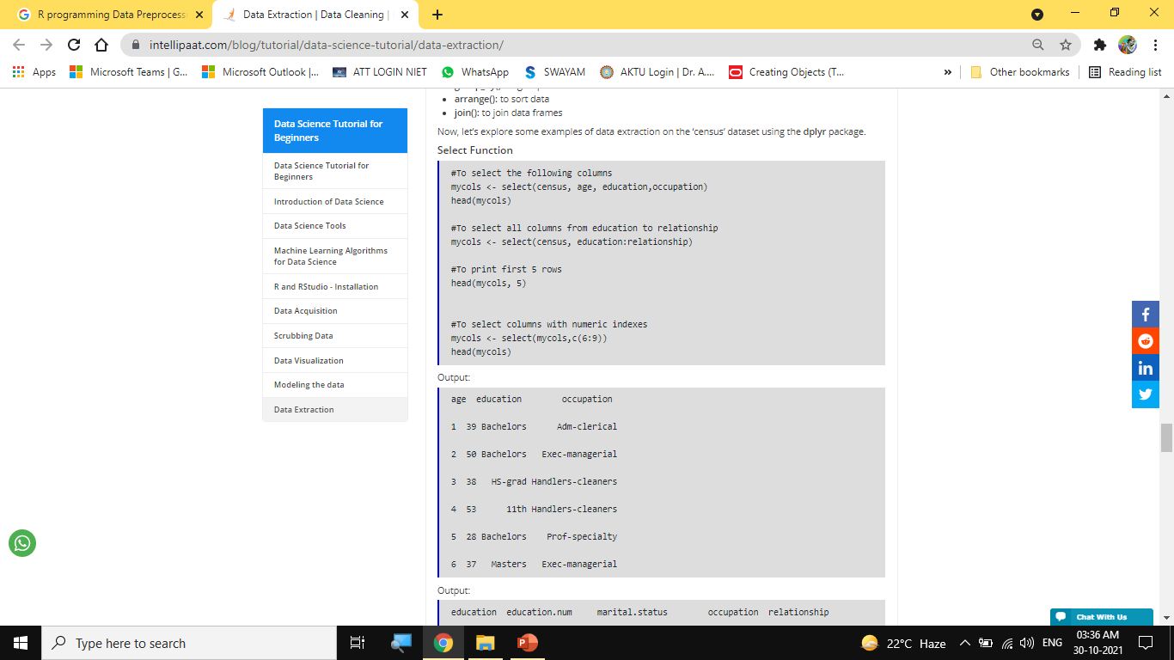
Data Preprocessing– Attribute and its types Understanding and extracting useful variables.

Slide 107
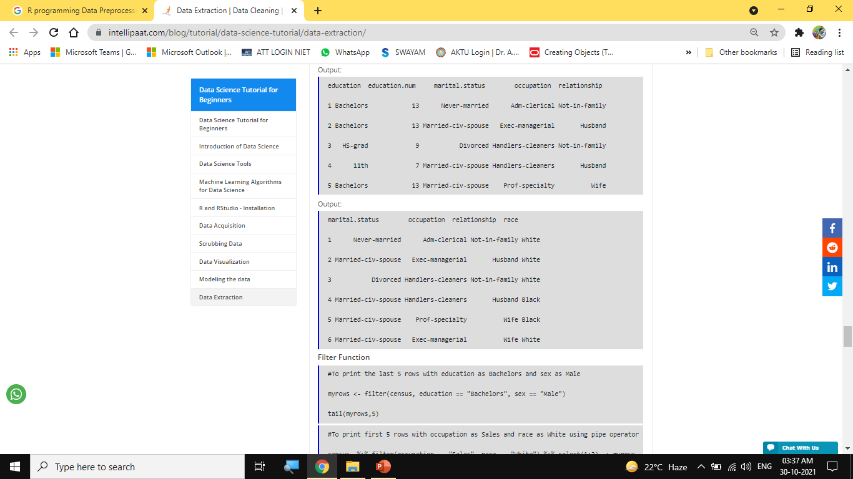
Data Preprocessing– Attribute and its types Understanding and extracting useful variables.

Slide 108

Data Preprocessing– Attribute and its types Understanding and extracting useful variables.

Slide 109
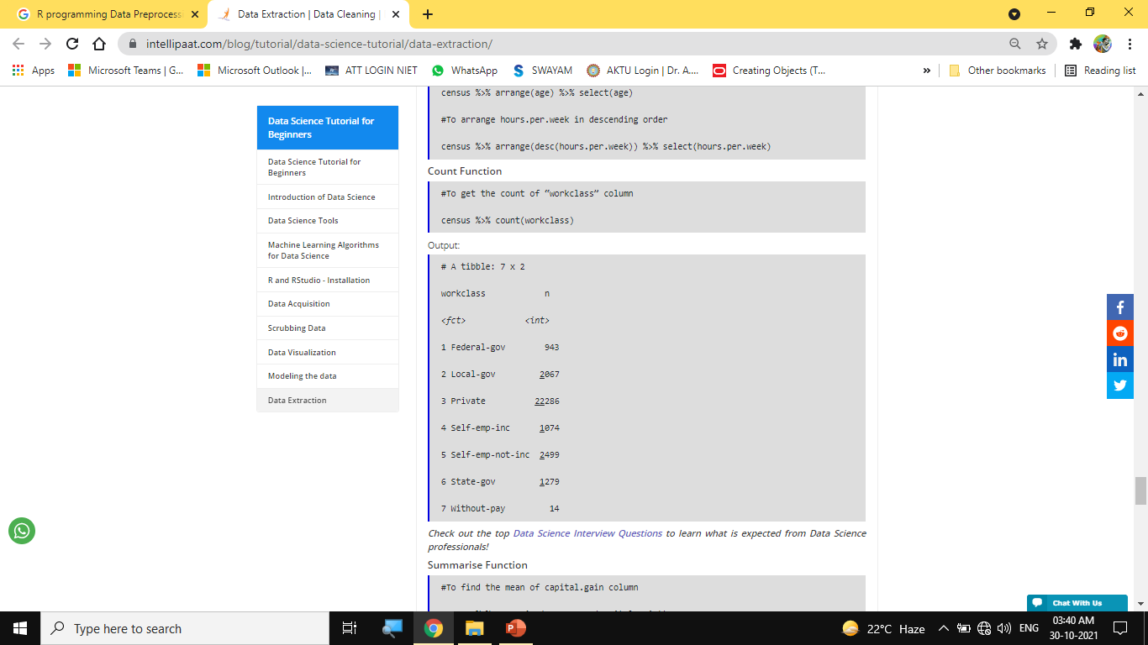
Data Preprocessing– Attribute and its types Understanding and extracting useful variables.

Slide 110
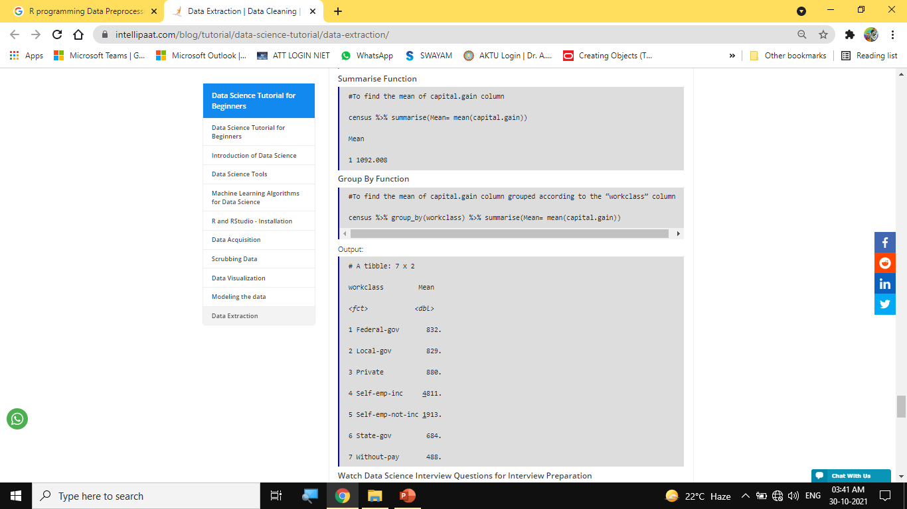
Data Preprocessing– Attribute and its types Understanding and extracting useful variables.

Slide 111
Handling missing data, data cleaning, removing Redundant variables, variable Selection
Objective:
This topic deals with the concept of Data cleaning is the process of transforming dirty data into reliable data that can be analyzed. Data cleansing improves your data quality and overall productivity.
Recap:
Revision R fundamentals for Programming.

Slide 112
Handling missing data, data cleaning, removing Redundant variables, variable Selection
How to clean the datasets in R?
How to clean the datasets in R?, Data cleansing is one of the important steps in data analysis. Multiple packages are available in r to clean the data sets, here we are going to explore the janitor package to examine and clean the data.
Data cleaning is the process of transforming dirty data into reliable data that can be analyzed. Data cleansing improves your data quality and overall productivity.
When you clean your data, all incorrect information is gone and leaving only reliable quality information.
The main functions of the Janitor package are
Format ugly data frame column names
Isolate duplicate records in the data frame
Provide quick tabulations
Format tabulation results

Slide 113
Handling missing data, data cleaning, removing Redundant variables, variable Selection
This package follows the principles of the “tidyverse” and in particular works well with the %>% pipe function. janitor package was built with beginning-to-intermediate R users in mind and is optimized for user-friendliness.
How to clean the datasets in R?
Load library
#install.packages("janitor")
library(janitor)
library(dplyr)
Getting data
data<-read.csv("D:/RStudio/Website/FinData.csv",1)

Slide 114

Handling missing data, data cleaning, removing Redundant variables, variable Selection

Slide 115

Handling missing data, data cleaning, removing Redundant variables, variable Selection

Slide 116

Handling missing data, data cleaning, removing Redundant variables, variable Selection
,"col"))

Slide 117

Handling missing data, data cleaning, removing Redundant variables, variable Selection

Slide 118

Handling missing data, data cleaning, removing Redundant variables, variable Selection

Slide 119

Handling missing data, data cleaning, removing Redundant variables, variable Selection

Slide 120
Identifying outliers, Removing Outliers, Removing Rows with missing values, or human error, Analyzing relationships between variables.
Objective:
This topic deals with the concept of outliers as there are no specific R functions to remove outliers . You will first have to find out what observations are outliers and then remove them , i.e. finding the first and third quartile (the hinges) and the interquartile range to define numerically the inner fences.
Recap:
Revision Programming fundamentala.

Slide 121
Identifying outliers, Removing Outliers, Removing Rows with missing values, or human error, Analyzing relationships between variables.
How to Remove Outliers in R
Statisticians often come across outliers when working with datasets and it is important to deal with them because of how significantly they can distort a statistical model.
Your dataset may have values that are distinguishably different from most other values, these are referred to as outliers. Usually, an outlier is an anomaly that occurs due to measurement errors but in other cases, it can occur because the experiment being observed experiences momentary but drastic turbulence. In either case, it is important to deal with outliers because they can adversely impact the accuracy of your results, especially in regression models.
In this tutorial, I’ll be going over some methods in R that will help you identify, visualize and remove outliers from a dataset.

Slide 122
Identifying outliers, Removing Outliers, Removing Rows with missing values, or human error, Analyzing relationships between variables.
Looking at Outliers in R
As I explained earlier, outliers can be dangerous for your data science activities because most statistical parameters such as mean, standard deviation and correlation are highly sensitive to outliers. Consequently, any statistical calculation based on these parameters is affected by the presence of outliers.
Whether it is good or bad to remove outliers from your dataset depends on whether they affect your model positively or negatively. Remember that outliers aren’t always the result of badly recorded observations or poorly conducted experiments. They may also occur due to natural fluctuations in the experiment and might even represent an important finding of the experiment.
Whether you’re going to drop or keep the outliers requires some amount of investigation. However, it is not recommended to drop an observation simply because it appears to be an outlier.
Statisticians have devised several ways to locate the outliers in a dataset. The most common methods include the Z-score method and the Interquartile Range (IQR) method. However, I prefer the IQR method because it does not depend on the mean and standard deviation of a dataset and I’ll be going over this method throughout the tutorial.

Slide 123
Identifying outliers, Removing Outliers, Removing Rows with missing values, or human error, Analyzing relationships between variables.
The interquartile range is the central 50% or the area between the 75th and the 25th percentile of a distribution. A point is an outlier if it is above the 75th or below the 25th percentile by a factor of 1.5 times the IQR.
For example, if
Q1= 25th percentile
Q3= 75th percentile
Then, IQR= Q3 – Q1
And an outlier would be a point below [Q1- (1.5)IQR] or above [Q3+(1.5)IQR].
If this didn’t entirely make sense to you, don’t fret, I’ll now walk you through the process of simplifying this using R and if necessary, removing such points from your dataset. For starters, we’ll use an in-built dataset of R called “warpbreaks”. It neatly shows two distinct outliers which I’ll be working with in this tutorial.

Slide 124
Identifying outliers, Removing Outliers, Removing Rows with missing values, or human error, Analyzing relationships between variables.
You can load this dataset on R using the data function.
data("warpbreaks")
Once loaded, you can begin working on it.
Visualizing Outliers in R
One of the easiest ways to identify outliers in R is by visualizing them in boxplots. Boxplots typically show the median of a dataset along with the first and third quartiles. They also show the limits beyond which all data values are considered as outliers. It is interesting to note that the primary purpose of a boxplot, given the information it displays, is to help you visualize the outliers in a dataset.
You can create a boxplot to identify your outliers using:

Slide 125

Identifying outliers, Removing Outliers, Removing Rows with missing values, or human error, Analyzing relationships between variables.

Slide 126

Identifying outliers, Removing Outliers, Removing Rows with missing values, or human error, Analyzing relationships between variables.

Slide 127
Identifying outliers, Removing Outliers, Removing Rows with missing values, or human error, Analyzing relationships between variables.
Finding Outliers – Statistical Methods
Now that you have some clarity on what outliers are and how they are determined using visualization tools in R, I can proceed to some statistical methods of finding outliers in a dataset.
This important because visualization isn’t always the most effective way of analyzing outliers. You can’t always look at a plot and say, “oh! this is an outlier because it’s far away from the rest of the points”. Your data set may have thousands or even more observations and it is important to have a numerical cut-off that differentiates an outlier from a non-outlier. This allows you to work with any dataset regardless of how big it may be.
Building on my previous discussion of the IQR method to find outliers, I’ll now show you how to implement it using R.
I’ll be using the quantile() function to find the 25th and the 75th percentile of the dataset, and the IQR() function which elegantly gives me the difference of the 75th and 25th percentiles.

Slide 128

Identifying outliers, Removing Outliers, Removing Rows with missing values, or human error, Analyzing relationships between variables.

Slide 129

Identifying outliers, Removing Outliers, Removing Rows with missing values, or human error, Analyzing relationships between variables.

Slide 130
Identifying outliers, Removing Outliers, Removing Rows with missing values, or human error, Analyzing relationships between variables.
Other Ways of Removing Outliers
Now that you know what outliers are and how you can remove them, you may be wondering if it’s always this complicated to remove outliers. Fortunately, R gives you faster ways to get rid of them as well.
The one method that I prefer uses the boxplot() function to identify the outliers and the which() function to find and remove them from the dataset.
First, we identify the outliers:
boxplot(warpbreaks$breaks, plot=FALSE)$out
Then save the outliers in a vector:
outliers <- boxplot(warpbreaks$breaks, plot=FALSE)$out
This vector is to be excluded from our dataset. The which() function tells us the rows in which the outliers exist, these rows are to be removed from our data set. However, before removing them, I store “warpbreaks” in a variable, suppose x, to ensure that I don’t destroy the dataset.

Slide 131
Identifying outliers, Removing Outliers, Removing Rows with missing values, or human error, Analyzing relationships between variables.
x<-warpbreaks ﻿
x<- x[-which(x$breaks %in% outliers),]
I have now removed the outliers from my dataset using two simple commands and this is one of the most elegant ways to go about it. R gives you numerous other methods to get rid of outliers as well, which, when dealing with datasets are extremely common. However, being quick to remove outliers without proper investigation isn’t good statistical practice, they are essentially part of the dataset and might just carry important information. Losing them could result in an inconsistent model.

Slide 132
Determining correlation
Objective:
In this topic we learn about the correlation coefficient which is determined by dividing the covariance by the product of the two variables' standard deviations. Standard deviation is a measure of the dispersion of data from its average. Covariance is a measure of how two variables change together.
Recap:
Revision of basic statistical approaches.

Slide 133
Determining correlation
Correlation:
Correlation explains how one or more variables are related to each other. These variables can be input data features which have been used to forecast our target variable.
Correlation, statistical technique which determines how one variables moves/changes in relation with the other variable. It gives us the idea about the degree of the relationship of the two variables. It’s a bi-variate analysis measure which describes the association between different variables. In most of the business it’s useful to express one subject in terms of its relationship with others.
For example: No of testing vs no of positive cases in Corona.
1. If two variables are closely correlated, then we can predict one variable from the other.
2. Correlation plays a vital role in locating the important variables on which other variables depend.
3. It’s used as the foundation for various modeling techniques.
4. Proper correlation analysis leads to better understanding of data.
5. Correlation contribute towards the understanding of causal relationship (if any).

Slide 134

Determining correlation
Positive Correlation: Two features (variables) can be positively correlated with each other. It means that when the value of one variable increase then the value of the other variable(s) also increases.

Slide 135

Determining correlation
Negative Correlation: Two features (variables) can be negatively correlated with each other. It means that when the value of one variable increase then the value of the other variable(s) decreases.

Slide 136

Determining correlation
No Correlation: Two features (variables) are not correlated with each other. It means that when the value of one variable increase or decrease then the value of the other variable(s) doesn’t increase or decreases.

Slide 137
Feature selection
Objective:
In this topic we learn about Feature selection which is the process of reducing the number of input variables when developing a predictive model. It is desirable to reduce the number of input variables to both reduce the computational cost of modeling and, in some cases, to improve the performance of the model.
Recap:
Revision of basic statistical approaches.

Slide 138
Feature selection
Unsupervised Techniques: These techniques can be used for unlabeled data.
From a taxonomic point of view, these techniques are classified as under:
A. Filter methods
B. Wrapper methods
C. Embedded methods
D. Hybrid methods
In this article, we will discuss some popular techniques of feature selection in machine learning.
A. Filter methods
Filter methods pick up the intrinsic properties of the features measured via univariate statistics instead of cross-validation performance. These methods are faster and less computationally expensive than wrapper methods. When dealing with high-dimensional data, it is computationally cheaper to use filter methods.
Let’s, discuss some of these techniques:
Information Gain
Information gain calculates the reduction in entropy from the transformation of a dataset. It can be used for feature selection by evaluating the Information gain of each variable in the context of the target variable.

Slide 139
Feature selection
Chi-square Test
The Chi-square test is used for categorical features in a dataset. We calculate Chi-square between each feature and the target and select the desired number of features with the best Chi-square scores. In order to correctly apply the chi-squared in order to test the relation between various features in the dataset and the target variable, the following conditions have to be met: the variables have to be categorical, sampled independently and values should have an expected frequency greater than 5.

Slide 140

Feature selection

Slide 141
Feature selection
Fisher’s Score
Fisher score is one of the most widely used supervised feature selection methods. The algorithm which we will use returns the ranks of the variables based on the fisher’s score in descending order. We can then select the variables as per the case.
Correlation Coefficient
Correlation is a measure of the linear relationship of 2 or more variables. Through correlation, we can predict one variable from the other. The logic behind using correlation for feature selection is that the good variables are highly correlated with the target. Furthermore, variables should be correlated with the target but should be uncorrelated among themselves.
If two variables are correlated, we can predict one from the other. Therefore, if two features are correlated, the model only really needs one of them, as the second one does not add additional information. We will use the Pearson Correlation here.

Slide 142

Feature selection

Slide 143
Feature selection
We need to set an absolute value, say 0.5 as the threshold for selecting the variables. If we find that the predictor variables are correlated among themselves, we can drop the variable which has a lower correlation coefficient value with the target variable. We can also compute multiple correlation coefficients to check whether more than two variables are correlated to each other. This phenomenon is known as multicollinearity.
Variance Threshold
The variance threshold is a simple baseline approach to feature selection. It removes all features which variance doesn’t meet some threshold. By default, it removes all zero-variance features, i.e., features that have the same value in all samples. We assume that features with a higher variance may contain more useful information, but note that we are not taking the relationship between feature variables or feature and target variables into account, which is one of the drawbacks of filter methods.

Slide 144
Feature selection

Slide 145

Feature selection
Mean Absolute Difference (MAD)
‘The mean absolute difference (MAD) computes the absolute difference from the mean value. The main difference between the variance and MAD measures is the absence of the square in the latter. The MAD, like the variance, is also a scale variant.’ This means that higher the MAD, higher the discriminatory power.

Slide 146
Feature selection
Dispersion ratio
‘Another measure of dispersion applies the arithmetic mean (AM) and the geometric mean (GM). For a given (positive) feature Xi on n patterns, the AM and GM are given by
respectively; since AMi ≥ GMi, with equality holding if and only if Xi1 = Xi2 = …. = Xin, then the ratio
can be used as a dispersion measure. Higher dispersion implies a higher value of Ri, thus a more relevant feature. Conversely, when all the feature samples have (roughly) the same value, Ri is close to 1, indicating a low relevance feature.’

Slide 147


Feature selection

Slide 148

Feature selection
B. Wrapper Methods:
Wrappers require some method to search the space of all possible subsets of features, assessing their quality by learning and evaluating a classifier with that feature subset. The feature selection process is based on a specific machine learning algorithm that we are trying to fit on a given dataset. It follows a greedy search approach by evaluating all the possible combinations of features against the evaluation criterion. The wrapper methods usually result in better predictive accuracy than filter methods.
Let’s, discuss some of these techniques:
Forward Feature Selection
This is an iterative method wherein we start with the best performing variable against the target. Next, we select another variable that gives the best performance in combination with the first selected variable. This process continues until the preset criterion is achieved.

Slide 149

Feature selection
This method works exactly opposite to the Forward Feature Selection method. Here, we start with all the features available and build a model. Next, we the variable from the model which gives the best evaluation measure value. This process is continued until the preset criterion is achieved.
This method along with the one discussed above is also known as the Sequential Feature Selection method.

Slide 150

Feature selection
Exhaustive Feature Selection
This is the most robust feature selection method covered so far. This is a brute-force evaluation of each feature subset. This means that it tries every possible combination of the variables and returns the best performing subset.

Slide 151

Feature selection
Recursive Feature Elimination
‘Given an external estimator that assigns weights to features (e.g., the coefficients of a linear model), the goal of recursive feature elimination (RFE) is to select features by recursively considering smaller and smaller sets of features. First, the estimator is trained on the initial set of features and the importance of each feature is obtained either through a coef_ attribute or through a feature_importances_ attribute.
Then, the least important features are pruned from the current set of features. That procedure is recursively repeated on the pruned set until the desired number of features to select is eventually reached.’

Slide 152
Feature selection
C. Embedded Methods:
These methods encompass the benefits of both the wrapper and filter methods, by including interactions of features but also maintaining reasonable computational cost. Embedded methods are iterative in the sense that takes care of each iteration of the model training process and carefully extracts those features which contribute the most to the training for a particular iteration.
Let’s, discuss some of these techniques :
LASSO Regularization
Regularization consists of adding a penalty to the different parameters of the machine learning model to reduce the freedom of the model, i.e. to avoid over-fitting. In linear model regularization, the penalty is applied over the coefficients that multiply each of the predictors. From the different types of regularization, Lasso or L1 has the property that is able to shrink some of the coefficients to zero. Therefore, that feature can be removed from the model.

Slide 153

Feature selection
Random Forest Importance
Random Forests is a kind of a Bagging Algorithm that aggregates a specified number of decision trees. The tree-based strategies used by random forests naturally rank by how well they improve the purity of the node, or in other words a decrease in the impurity (Gini impurity) over all trees. Nodes with the greatest decrease in impurity happen at the start of the trees, while notes with the least decrease in impurity occur at the end of trees. Thus, by pruning trees below a particular node, we can create a subset of the most important features.

Slide 154

Feature selection

Slide 155
Feature selection
Conclusion
We have discussed a few techniques for feature selection. We have on purpose left the feature extraction techniques like Principal Component Analysis, Singular Value Decomposition, Linear Discriminant Analysis, etc. These methods help to reduce the dimensionality of the data or reduce the number of variables while preserving the variance of the data.

Slide 156
Feature extraction
Objective:
In this topic we learn about Feature extraction which refers to the process of transforming raw data into numerical features that can be processed while preserving the information in the original data set. It yields better results than applying machine learning directly to the raw data.
Recap:
Revision of basic statistical approaches.

Slide 157
Feature extraction
What is Feature Extraction?
Feature extraction is a part of the dimensionality reduction process, in which, an initial set of the raw data is divided and reduced to more manageable groups. So when you want to process it will be easier. The most important characteristic of these large data sets is that they have a large number of variables. These variables require a lot of computing resources to process. So Feature extraction helps to get the best feature from those big data sets by selecting and combining variables into features, thus, effectively reducing the amount of data. These features are easy to process, but still able to describe the actual data set with accuracy and originality.
Why Feature Extraction is Useful?
The technique of extracting the features is useful when you have a large data set and need to reduce the number of resources without losing any important or relevant information. Feature extraction helps to reduce the amount of redundant data from the data set.
In the end, the reduction of the data helps to build the model with less machine effort and also increases the speed of learning and generalization steps in the machine learning process.

Slide 158
Feature extraction
Applications of Feature Extraction
Bag of Words- Bag-of-Words is the most used technique for natural language processing. In this process they extract the words or the features from a sentence, document, website, etc. and then they classify them into the frequency of use. So, in this whole process feature extraction is one of the most important parts.
Image Processing –Image processing is one of the best and most interesting domain. In this domain basically you will start playing with your images in order to understand them. So here we use many many techniques which includes feature extraction as well and algorithms to detect features such as shaped, edges, or motion in a digital image or video to process them.
Auto-encoders: The main purpose of the auto-encoders is efficient data coding which is unsupervised in nature. this process comes under unsupervised learning . So Feature extraction procedure is applicable here to identify the key features from the data to code by learning from the coding of the original data set to derive new ones.

Slide 159
Daily Quiz
Q1. What is Data Science?
Q2. Differentiate between Data Analytics and Data Science
Q3. What do you understand about linear regression?
Q4. What do you understand by logistic regression?
Q5. What is a confusion matrix?
Q6. What do you understand by true-positive rate and false-positive rate?
Q7. How is Data Science different from traditional application programming?
Q8. Explain the difference between Supervised and Unsupervised Learning.
Q9. What is the difference between the long format data and wide format data?
Q10. Mention some techniques used for sampling. What is the main advantage of sampling?
Q11. What is bias in Data Science?

Slide 160
Weekly/monthly/Unit Wise Assignment.
Assignment
1. What are the differences between supervised and unsupervised learning?
2. How is logistic regression done?
3. Differentiate between structured and unstructured datasets?
4. Mention What Is The Responsibility Of A Data Analyst?
5. What Is Required To Become A Data Analyst?
6. Mention What Are The Various Steps In An Analytics Project?
7. Mention What Is Data Cleansing?
8. List Out Some Of The Best Practices For Data Cleaning?
9. List Of Some Best Tools That Can Be Useful For Data-analysis?
10. Mention What Is The Difference Between Data Mining And Data Profiling?

Slide 161
Faculty Video Links, You tube & NPTEL Video Links and Online Courses Details
You Tube video
(1) Predictive Analytics Tutorial | Linear Regression in Python | Logistic Regression | Great Learning - YouTube
(2) Multiple Regression Analysis: Hypothesis Tests - YouTube
(3) Mod-06 Lec-28 Goodness of Fit - YouTube

Slide 162
MCQ unit wise/weekly

Slide 163
MCQ unit wise/weekly

Slide 164
MCQ unit wise/weekly

Slide 165
Glossary Questions

Slide 166

Semester Paper

Slide 167

Semester Paper

Slide 168

Semester Paper

Slide 169

Semester Paper

Slide 170
Expected Questions for University Exam
1. What Is A Recommender System?
2. Compare Sas, R And Python Programming?
3. Explain The Various Benefits Of R Language?
4. How Do Data Scientists Use Statistics?
5. What Is Logistic Regression?
6. Why Data Cleansing Is Important In Data Analysis?
7. Describe Univariate, Bivariate And Multivariate Analysis.?
8. How Machine Learning Is Deployed In Real World Scenarios?
9. What Are Some Of The Statistical Methods That Are Useful For Data-analyst?
10. Explain What Is The Criteria For A Good Data Model?

Slide 171
References
Text books
1. Dean Abbott ,“Applied Predictive Analytics Principles and Techniques for the Professional DataAnalyst” , Wiley.
2. “Fundamentals of Machine Learning for Predictive Data Analytics” By John D. Kelleher, Brian Mac Namee and Aoife D'Arcy
3. Predictive & Advanced Analytics (IBM ICE Publication)
Reference Books
1. “An Introduction to Statistical Learning: with Applications in R” by James, Witten, Hastie and Tibshirani, Springer, 1st. Edition, 2013.
2.“R for Everyone: Advanced Analytics and Graphics” by Lander, J., Addison-Wesley Data & Analytics Series, 1 edition, 2013.
3.Sandeep Rakshit, R for Beginners, McGraw Hill (2017).

Slide 172
Recap
This unit provide us fundamentals domain of Data Science and its latest trends in industry.
In this unit we are also benefitted with the knowledge of different types of data and very important is the implementation of machine learning and also through the concept model building which is used in industry prospects.
This unit will impart us with knowledge of business analytics and tolls used in data science.

Slide 173
CONTENTS
Thank You

